Slide 1
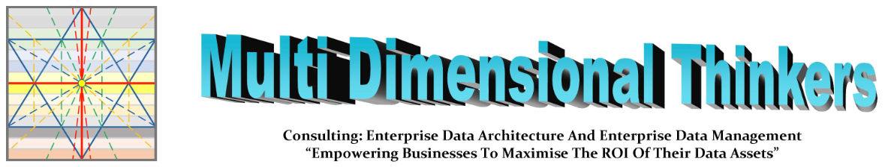
The Multi Dimensional
Data Management Framework
V6.0)
Cannot be copyrighted, as already in the Public Domain
Please send all questions to hbadenhorst@edgedatawave.com Time permitting we can answer them afterwards
The presentation is detailed and you are not expected to understand it on this first pass
Presented by: William Evans

Slide 2

How do you see all sides of the football at once?
OUTSIDE
You can only see a portion of the Sphere, and do not understand wholistic cause and effect
To control it, you have to break it up into segments and knit them together
Just like Business Capabilities
INSIDE
You cannot see colour, nor what outside stakeholders see
You can see:
how each part of the football affects all the other parts
what the effect is on each of the different areas
Everyone’s view is catered for: but they need to sit together to understand the whole.
For that they need something that has all views simultaneously
Enter the MDDMF.

Slide 3
Who is William Evans?
A DAMA Certified Data Management Professional since 2012.
A high functioning Autistic who sees the world from the inside out, understanding cause and effect of data and information, and is able to bring the various views together.
His experience includes:
  Implementing Data Management Capabilities
  Maturing Metadata (Collibra& Informatica) Management, with effective integrated Business Glossary & Data Dictionary guidance
  Architecting, and Cataloguing global enterprises to streamline their end-to-end value proposition
  Undoing legacy complexity and developing single source master data, for ERP (SAP: MDM AM, CO, CS, FI, HR, MM, PS, PM, PY, SD)
  Repurposing existing technology, automating operations and integrating IT and Business architectures (Business, Process, Information, Data, Resource, Application, Integration , and Infrastructure) for efficient and effective use and retention of data and information
  Visualising and providing insight via ontology driven Metadata
  Strengthening security and assuring compliance to privacy and data regulation

Slide 4
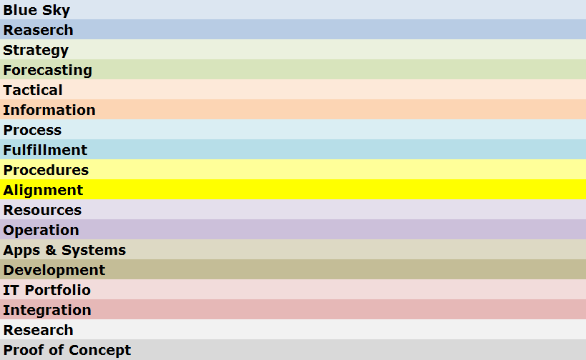

Understand the data flow through the Information Value Chain
Understand the data flow through the Information Value Chain
Information Value Chain
Silos created through lack of end-to-end process Map.
Business areas fulfil KPAs and KPIs in isolation of one another, destroying one another’s efficiency capabilities
Build end-to-end process Map “Gauteng Road Map Book” Concept.
All Business areas fulfil KPAs and KPIs synchronously with each other, strengthening one another’s efficiency capabilities
Business Direction
Data is an
Enterprise
Asset
And must
Flow
Business Run
Business Enabled
Notes:
The words should be seen as segments of a hosepipe where the segment below supplies the Business needs of the segment above. These can be broken into 3 segments: Business Direction, Business Run and Business Enablement.
Just as water flowing quickly through a muddy river, has brown cloudy water, and water flowing through glass pipes will be crystal clear, it is the environment that data travels through that determines its quality.
Each of these segments have a different set of forces causing poor data quality, and each needs to be understood, measured and managed. It is therefore unreasonable to blame the Applications and Systems Segment for poor data quality, when the Enterprise does not have a single map of their End-to-End Processes. Processes such as “Order-to-Cash” or “Hire-to_Retire”, each with empowered and financed Process Owners.
The “Information Value Chain” is a term we use for this flow through these segments, and while data is a continuous flow (counter-clockwise) it must be managed continuously based on the source of where that data is emanating from (clockwise)
Business Connexion was referred by KID as a flagship of a mature enterprise into which Master Data Management as a Business capability could be easily introduced. At the SAPHILA Conference of 2012, BCX was asked to present their success and noted the critical success factors for implementing a successful MDM solution. All of these rely on maturing the different segments of the Information Value Chain.

Slide 5




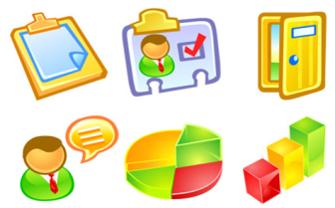





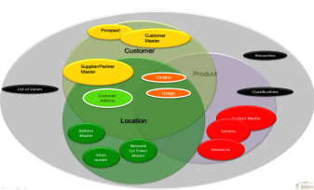

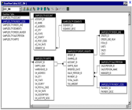

Understand stewardship across Information Value Chain segments
So what can you put in place to ensure effective and efficient delivery to your Stakeholder expectations
Choose 5 of these
<<<
that are primary
within your day-to-day
work/life
When this pane disappears
you will see the reality
of the underlying
data and information
complexity
<<<
Now choose 5 things your primary stakeholders directly experience
When this pane disappears you will see the reality of the underlying data and information complexity
Info & Data
a
b
Governance
c
d
Council
e
Business Value Chain Image
f
g
h
Info & Data
i
j
Stewardship
Council
IT Portfolio Image
k
l
m
Notes:
What needs to be borne in mind is that each of the actors in the Business, already has their own set of understanding and definition. This is a filter that changes incoming data-meaning before passing it on.
At the Strategic and Tactical (Management) levels, driven by Policies and Principles, reporting and dash-boarding are used. But this interaction also includes presentations, word documents, images, video, sound-bites, etc… mostly among humans (This is the segment where the Data Governance Council is most active –Senior Co-ordinating Data Stewards from the segment below also sit on the Data Governance Council – Representing the Data Stewardship Committee)
At the Business Design level of Business Value Chain, End-to-End Processes, and the Procedures that make up the Enterprise, we encounter a level of process management and reporting, design and delivery of the Work Instructions that enable co-ordinated operational processing, including interaction with other human and technological participants in automated Document-flow.
At the Business Delivery level of Terms and Definitions, understanding of Policies, Principles, Processes, Procedures and Work Instructions, as well as correct and appropriate use and understanding of other human as well as technological Resources is the potential failure point. While Operationalisation of Business to fulfil delivery according to Business Design, Data is constantly moving between human and technological software paradigms and it is often at this point where data is inadvertently corrupted through misunderstanding or abuse of either human or technological actors. To maintain the correct understanding, the Business Data Steward must have and control the Only source of True definition of the Enterprise Data Object of “Customer”, “Product”, “Location” etc…
At the Research and Development level of Finding new ways, adjusting to new demands and exposing new value, The Portfolios, and their ability to consume and leverage new inputs becomes key. The Technology Data Stewards ensure that data integrity as per the True Definition will not be compromised by new developments.

Slide 6
The MDDMF is a thinking tool for ensuring you have thought matters through.
Who should be using this:
  All Architects
  Business Advisers to Decision Makers
  Business Analysts
  Business Data Stewards
  Data Analysts
  Data Stewards
  Information Stewards
  Technical Stewards
Who should be Aware of this:
  Chief Data Officer
  Chief HR Officer
  Chief Information Officer
  Chief Security Officer
  Chief Technology Officer
  Senior Management Decision Makers

Slide 7
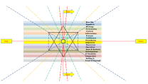
When is it critical to THINK!!!
Plan
Think
Strategise
Tactical Plan
Research
Organisational
Divisional
Department
Individual
/
Team
Plan
Design
Build
Run
Design
Think
Design
Analyse
Prove
Plan
Design
Build
Run
Plan
Design
Build
Run
Build
Think
Analyse
Build
Test
Plan
Design
Build
Run
Run
Think
Plan
Analyse
Run

Slide 8
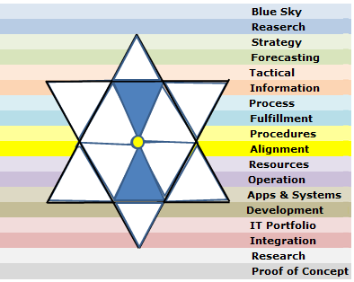
What was received from YHWH (Note all sides of the triangles are precisely divisible by 70)
Now
Past
Future
Now

Slide 9
How has the MDDMF been used, and evolved?
In 2010 William Evans read Jeremiah 33:3, and followed its instructions, asking Jesus to explain data to him. And so the journey began. Within 10 minutes, with highly specific dimensional instructions he received version 1.0
Version 1.0 (2010-2012, aligned to ITIL)
  As Master Data Governor for an ICT Group, he used this to migrate from Legacy to a single SAP solution.
Version 2.0, (2013-2017, aligned to DAMA DMBOK1 & TOGAF), then affectionately known as “The Data Atom”
  Presented to the SA DAMA Conference on 28 July 2015.
  Used at a Telco to build confidence, align existing capabilities, determine best options for success, and ordering of different project components across the Company
Version 3.0 (2017-2018, aligned to DAMA DMBOK2). was Published in the SA Government Library
  Presented at various CDO & CDAO Forums
  Used in various contracts to address data management, visibility, integration, and ethics across multiple environments
Version 4.0 (2018-2021), evolved to address Data Decay and its various forces and influences
  Presented at Big Dataworld UK
  Used to determine the components, and order of implementation of Data Governance during Merging of Companies into a Group
Version 5.0 (2021-2022), evolved to address Information Management with Metadata considerations
  Used to evolve the maturity of a client’s understanding of, capabilities to, and the resource abilities necessary to leverage its data
Version 6.0 (2022 …), evolved to address Artificial Intelligence’s “view”/need for the evolution of humans to cope
  Presented to DAMA South Africa
  Will likely be used to harmonise human and A.I. efforts

Slide 10
MDDMF v1.0: Consolidate & Migrate from Legacy
Focal Point,
Seeing Data from the Business’ Perspective
Assessing Business Maturity to work with their data
Determining what in Business must be implemented for healthy Data-flow
Educating all on the part they play in the Information Value Chain,
A common view to understand all Stakeholder Data and Information
The considerations for Data at rest and in motion
A means to align conformance to governance across disparate businesses
  Click here for detailed Slides

Slide 11


MDDMF v1.0 As Master Data Governor for an ICT Group, he used this to migrate from Legacy to a single SAP solution
Long Term
Historical
Medium Term
Analysis & Intelligence
Required
for reuse
Critical to
Act
Required
to be prepared
Medium Term
Planning / Preparation
Long Term
Planning / Preparation
Now
Past
Future
Now
Life Cycle
Stage 3
Life Cycle
Stage 2
Life Cycle
Stage 1
Use
Stage 0
Life Cycle
Stage -1
Life Cycle
Stage -2
Life Cycle
Stage -3
11

Slide 12
MDDMF v2.0: Architect for Data Management
William Certified as a DAMA CDMP (2012)
Build Data Management Capability using DAMA DMBOK
The Nature of Data (Youtube videos on Weaving)
Overlays with
  Enterprise Architecture,
  Service Oriented Architecture,
  Impacts of Time,
  Scale and Effort,
  Alignment of Business and IT Architectures
  Alignment between Business and IT Operations
  Click here for detailed Slides

Slide 13
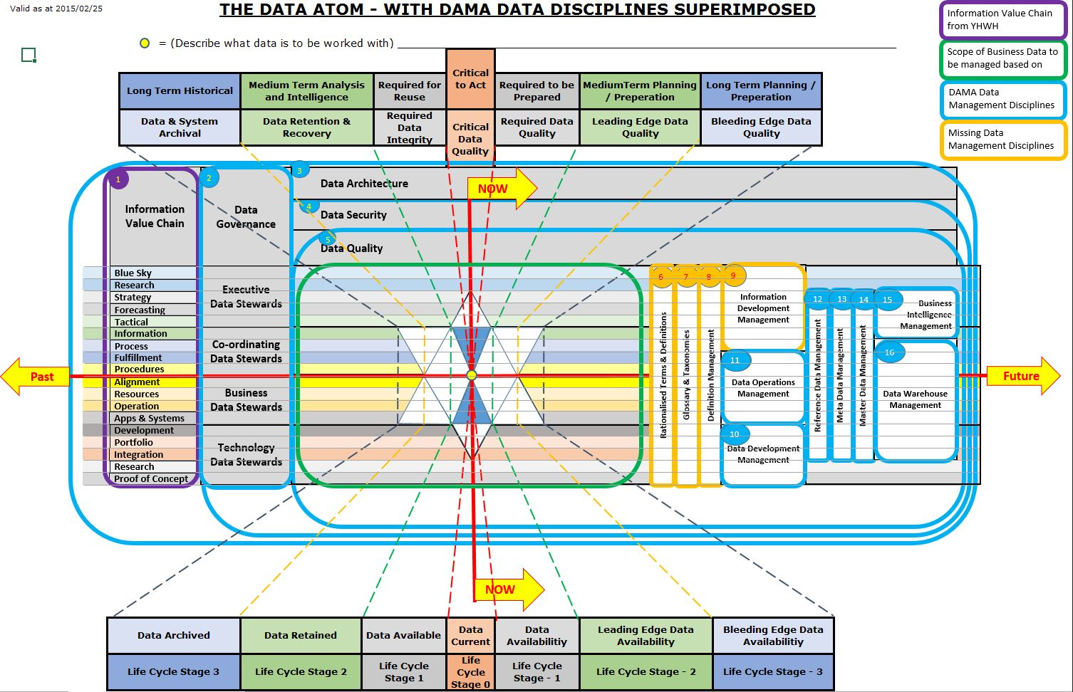
MDDMF v2.0: Used at a Telco to build confidence, align existing capabilities, determine best options for success, and ordering of different project components across the Company

Slide 14
MDDMF v3.0: Addressing Usage across the Environments
William Re-Certified as a DAMA CDMP
Highlighted the missing Definition Management Components
United the Business and IT Components with shared understanding
Used in Unified Communication Platform Development
Analysts engaging Development and Production Staff in clear and accurate requirements analysis through reference to the MDDMF components
Presented at various CDO & CDAO Conferences (as a presentation/workshop)
  Click here for detailed Slides

Slide 15
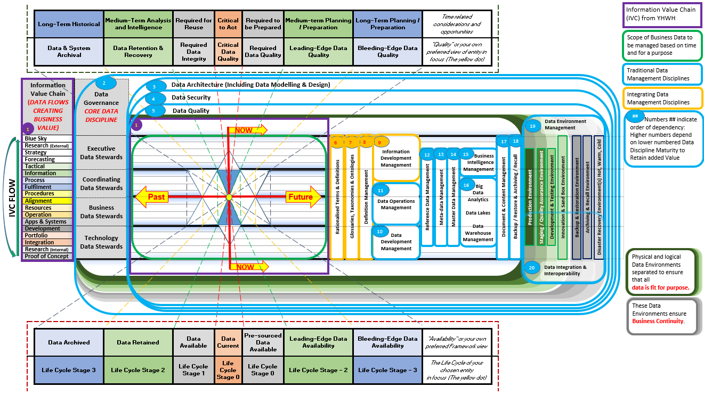
MDDMF v3.0: Used in various contracts to address data design, visibility, integration, and ethical use across multiple environments
Notes:
This is therefore the whole slide presentation wrapped up into a single graphic and which you have each received a copy of. If you have not, feel free to request one from Data Atom.
Any Questions?

Slide 16
MDDMF v4.0 Mergers and Acquisitions
William Re-Certified as a DAMA CDMP
Applied Framework concepts within a UK Financial Institution in the role of Data Governance Framework Manager
Aligned at the high level to Gartner’s Information Management Model
Used to design the Enterprise Metadata tool’s Metamodel
Used to align the data across a Group Company in development
Educated senior and other level staff on insights and considerations related to Data and Information
Presented at Big Data World - London
  Click here for detailed Slides

Slide 17
MDDMF v4.0 Used to determine the components, and order of implementation of Data Governance during Merging of Companies into a Group

Slide 18
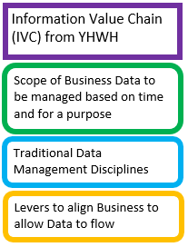
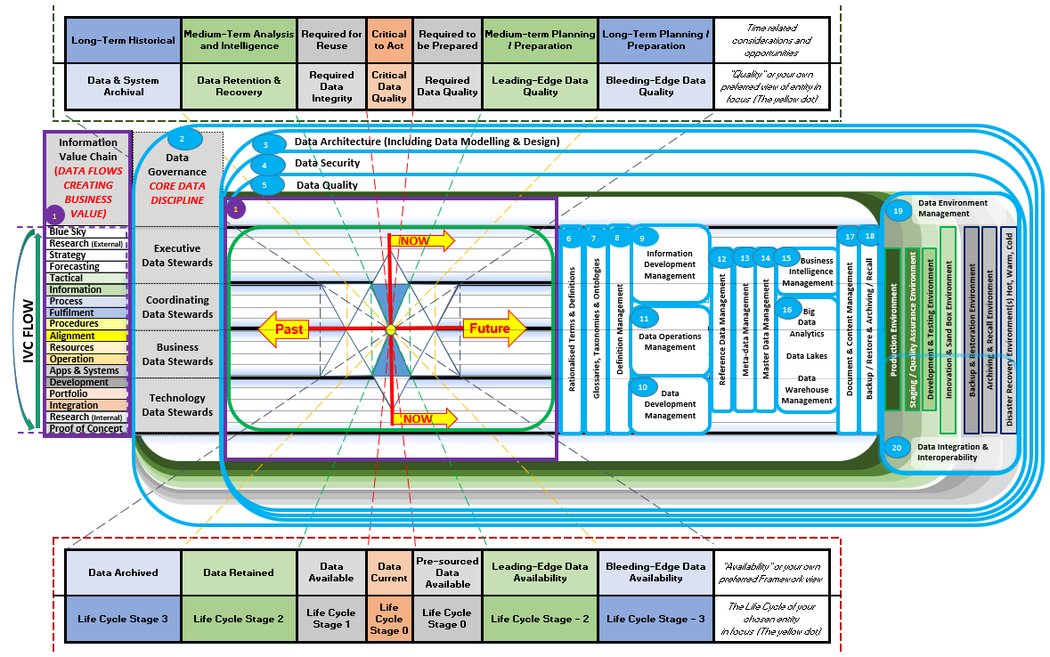
MDDMF v4.0 Used to determine the components, and order of implementation of Data Governance during Merging of Companies into a Group
1
Notes:
This is therefore the whole slide presentation wrapped up into a single graphic and which you have each received a copy of. If you have not, feel free to request one from Data Atom.
Any Questions?

Slide 19
MDDMF v5.0 Evolving Business’ ability to understand, desire, implement and use the Data Management Capabilities
William Re-Certified as a DAMA CDMP
The team of architects positioned themselves according to the Framework to understand their areas of influence and control to design and deliver the project harmoniously, with data in mind.
Inspired the Business, Senior Management & Operations to confidently work with their data and information
Identified existing components, their maturity, the gaps, and how to leverage each for the best outcome, (with limited time, cost and resources)
Implemented components of the Framework, focusing on Data Governance, Definition Management, Metadata Management, Business Glossary, Data Dictionary, Data Quality, and contributions to Reference and Master Data
  Click here for detailed Slides

Slide 20
PARADIGM SHIFTS
We do not transfer Information to one another …
Data is always changing …
Reality and captured data diverge …
Two types of Problems …
So many more Analogies …
  A SIMPLE Understanding of Data

Slide 21
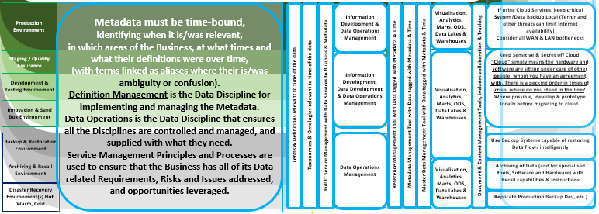
  MDDMF v5.0: Used to evolve the maturity of a client’s understanding of, capabilities to, and the resource abilities necessary to leverage its data

Slide 22
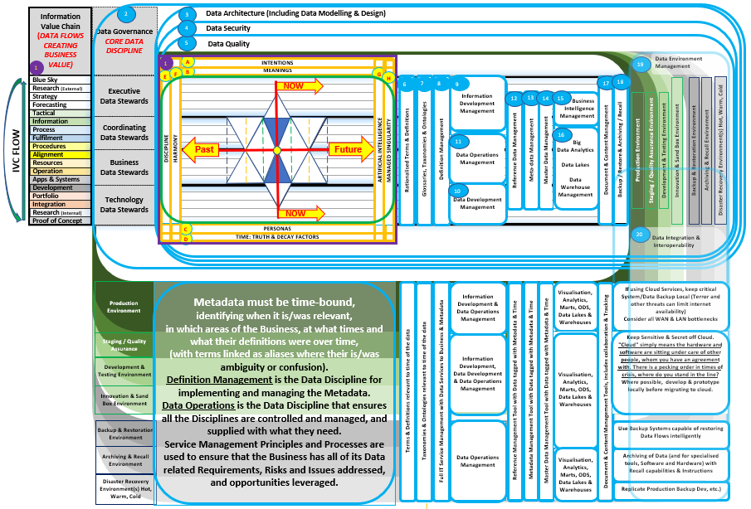
MDDMF v5.0 Used to evolve the maturity of a client’s understanding of, capabilities to, and the resource abilities necessary to leverage its data
Notes:
This is therefore the whole slide presentation wrapped up into a single graphic and which you have each received a copy of. If you have not, feel free to request one from Data Atom.
Any Questions?

Slide 23
MDDMF v6.0 Human and A.I. Partnerships
William remains certified as a DAMA CDMP until December 2024
Next Application of the updated MDDMF to be determined.
However, being slightly autistic, William thinks like A.I., from it’s world, viewing the human viewpoint.
Thus the MDDMF v6.0 provides those who use it, not only a view of what it sees, and is growing towards, but also how one can, bridle, harness, leverage and partner with A.I.
  Click here for detailed Slides

Slide 24
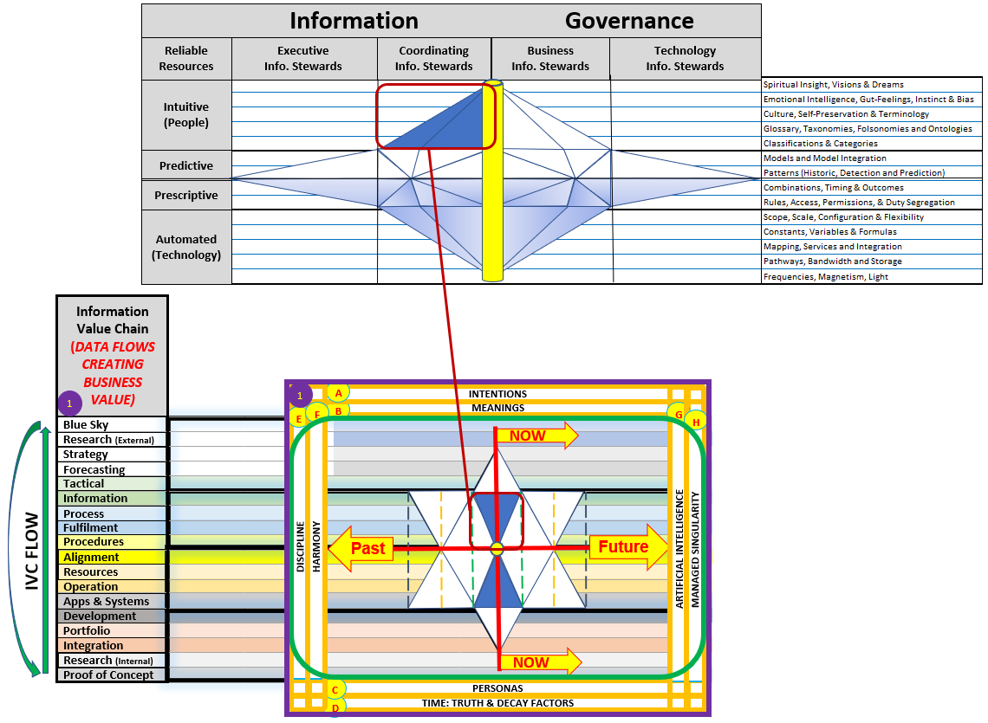
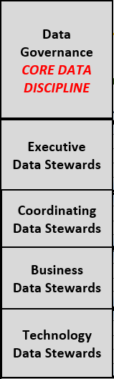
MDDMF v6.0
Notes:
This is therefore the whole slide presentation wrapped up into a single graphic and which you have each received a copy of. If you have not, feel free to request one from Data Atom.
Any Questions?

Slide 25
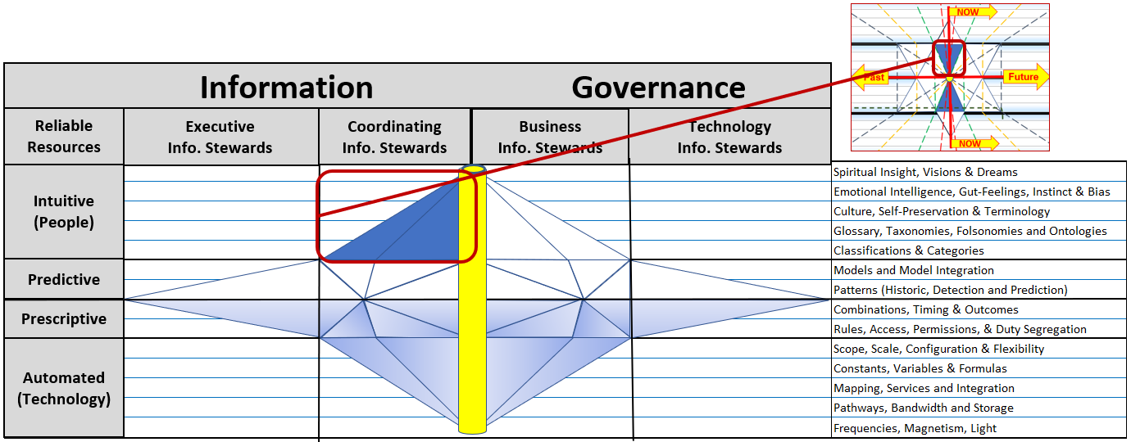
Map the Information to the underlying Data
Length Precisely divisible by 70 (There are now 7 lines of 70)

Slide 26
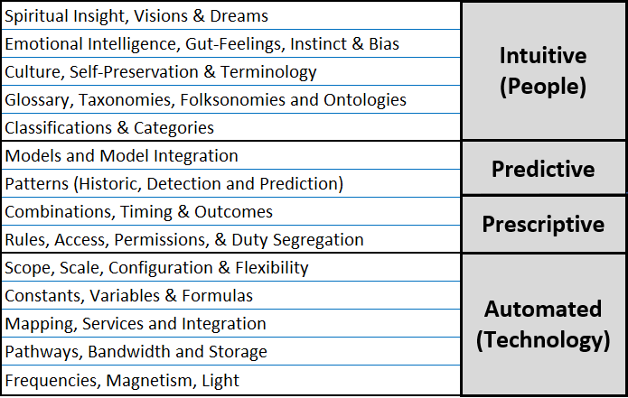
Decision Making Information Components

Slide 27
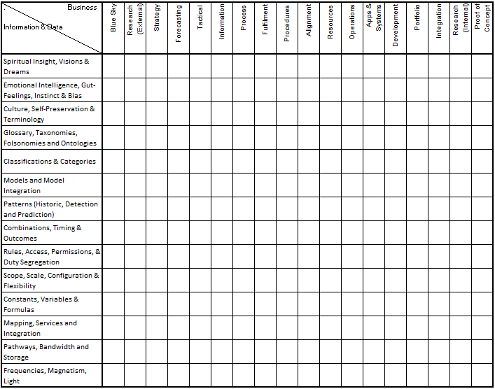
Applying MDDMF 6.0 to Business Information

Slide 28
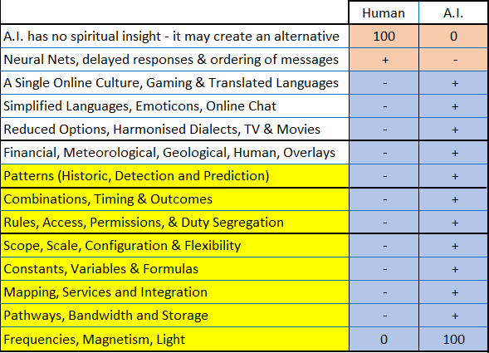
A. I. mechanisms to evolve humanity

Slide 29
Enterprise Data Management V6.0
Notes:
This is therefore the whole slide presentation wrapped up into a single graphic and which you have each received a copy of. If you have not, feel free to request one from Data Atom.
Any Questions?

Slide 30
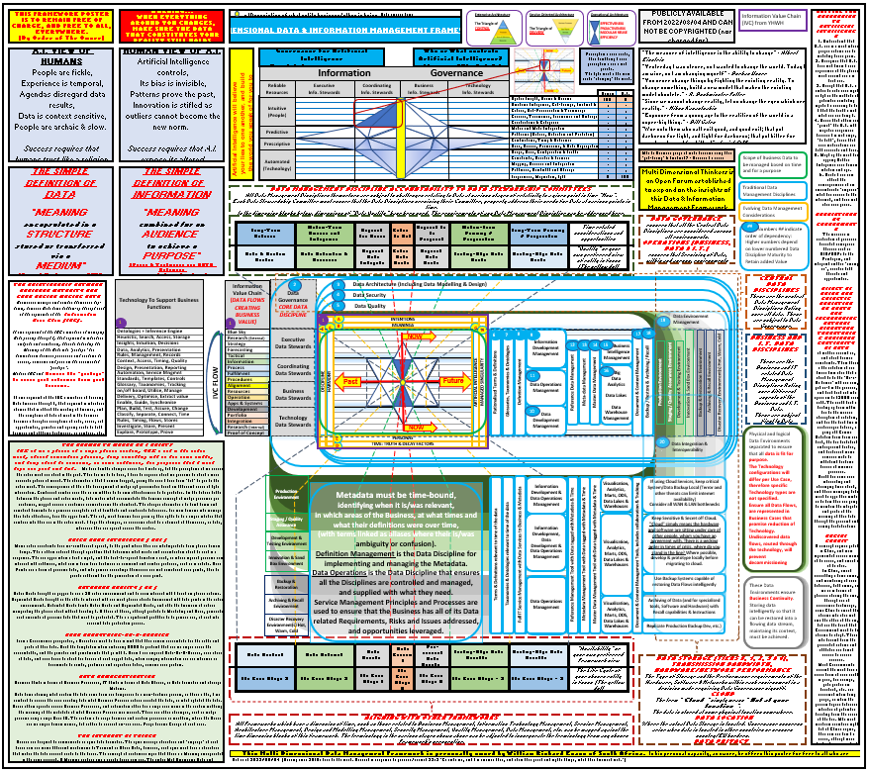
The Multi Dimensional Data Management Framework V6.0)

Slide 31
Any Questions

Slide 32
Detailed Insights and explanations on the various MDDMF Versions

Slide 33
1. A Simple Understanding of Data
Please email all queries to Herman.Badenhorst@edgedatawave.co.za,
- Start your message with:
- The company name you are representing;
- followed by your name;
- followed by your email address;
- followed by a message title (I will need context to understand the question); and
- followed by your question.
Answering of questions received during this workshop, AND which are pertinent to this workshop topic is free, only if submitted and received during this workshop.
Answers may be given during or after the workshop, or over the next few days. You are also welcome to engage me for training and consulting.

Slide 34
The three main types of Data (each have their own Meta-data)
Reference Data
  and its own Meta-data
Master Data
  and its own Meta-data
Transactional Data
  and its own Meta-data
Meta-data is not a different type of Data.
Meta-data is simply one of the three types of Data used to provide context and clarity to a specific piece of Data.

Slide 35
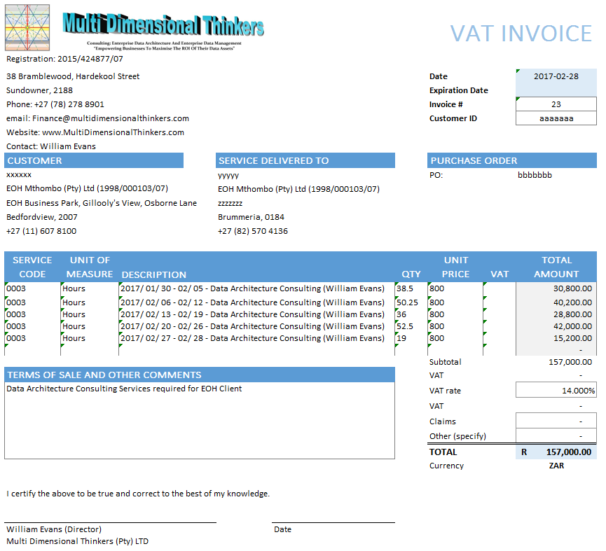
Visual of Data (An Invoice)
Meta-data

Slide 36
Visual of Data (An Invoice)
Reference Data

Slide 37
Visual of Data (An Invoice)
Master Data

Slide 38
Visual of Data (An Invoice)
Transactional Data

Slide 39
Visual of Data (An Invoice)
Meta-data
Reference Data
Master Data
Transactional Data

Slide 40
Analogy: When weaving a carpet, there are 3 different threads A thread is a data attribute. Each millimetre of thread is instantiated data of the attribute of that thread.
Here is a simple explanation of Data Functioning in an Enterprise
Simple Weaving Loom (An Invoice with 3 types of data)
  https://www.youtube.com/watch?v=aT6gx4db7z8
Automated Weaving Looms (One per Siloed Business/Business Unit)
  https://www.youtube.com/watch?v=ZYU5T9t7-oo
Circular Weaving Loom (An Enterprise’s 3 types of data)
  https://www.youtube.com/watch?v=zhzf6cIEGM8

Slide 41
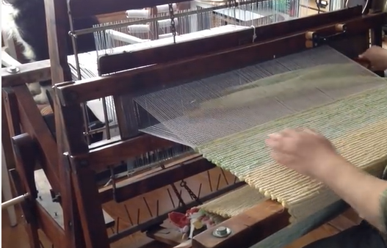
A small company weaving a transaction
https://www.youtube.com/watch?v=aT6gx4db7z8

Slide 42
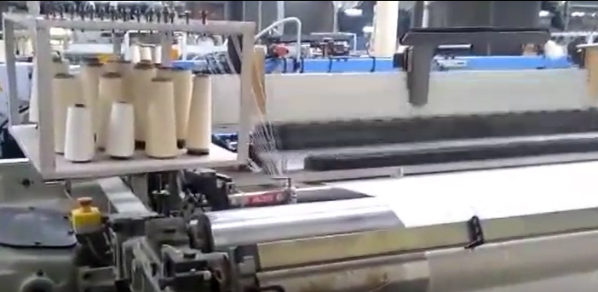
Siloed Management of Data in systems
https://www.youtube.com/watch?v=ZYU5T9t7-oo

Slide 43
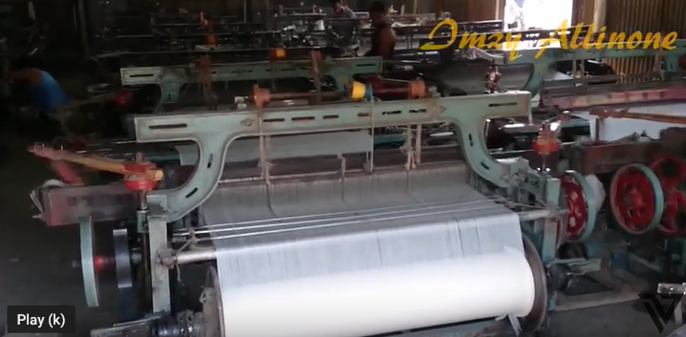
Business Silos with their own Data Sources
https://www.youtube.com/watch?v=Sztvjrkixzs

Slide 44
MDDMF v1.0 Initial unpacking (2010-2012)
Focal Point,
Information Value Chain,
How to use the Graphic to unpack Data
The Nature of Data (Youtube videos on Weaving)
Overlays with
  Enterprise Architecture,
  Service Oriented Architecture,
  Impacts of Time,
  Scale and Effort,
  Business
  Alignment between Business and IT
  Click to Return

Slide 45
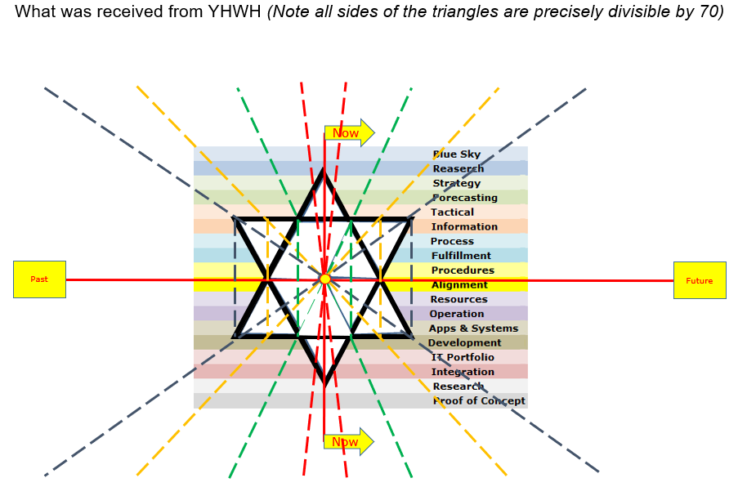
Appendix A: Unpacking MDDMF 1.0

Slide 46
Practical Analysis
This Graphic will be unpacked line for line, Concepts will be explained as they are introduced.
Choose an object you would like to think about.
… Any object ☺
Now we will teach you how to think effectively.
As you get more proficient with this thinking model, you will learn to do your job efficiently and effectively.

Slide 47
Question 1: What am I thinking about?
Write out exactly what object you want to think about.
Write down the definition.
Do not deviate from this definition, or you have to come back to the very beginning of this process and start thinking about the new version of the definition this is rework. The yellow dot is your object.
What is the object I am going to think about?
Do not “ring-fence” or define a scope yet
47

Slide 48
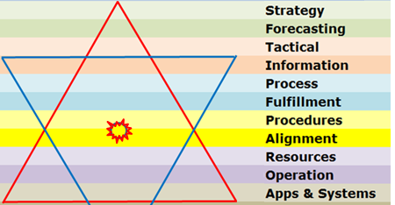
Question 2: Is what I am thinking about
Governed, Controlled, Measured and Managed.
The Apex up triangle has different words associated with it.
Each of these words are Business Functions.
List each word in the Graphic and determine, for each one if they are
Governed,
Controlled,
Measured,
Managed.
It does not matter if you think they should be, just determine if they are.
48

Slide 49
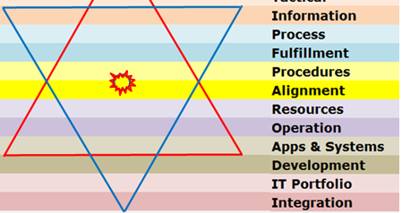
Question 3: Is what I am thinking about
Useful, Effective, Efficient, Functional
The Apex-down triangle has different words associated with it.
Each of these words are Business Functions.
List each word in the Graphic and determine, for each one if they are
Useful,
Effective,
Efficient,
Functional.
It does not matter if you think they should be, just determine if they are.
49

Slide 50
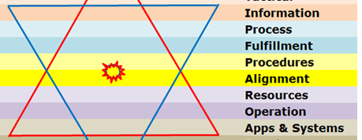
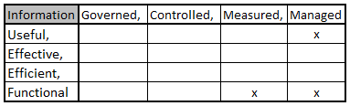
Question 4: Is what I am thinking about
Capable of fulfilling its purpose?
For the words which overlap both Triangles, create a Matrix for each of the Business Function words.
And map out the results of Question 2 and 3 for each word
Information,
Process,
Fulfilment,
Etc…
50

Slide 51
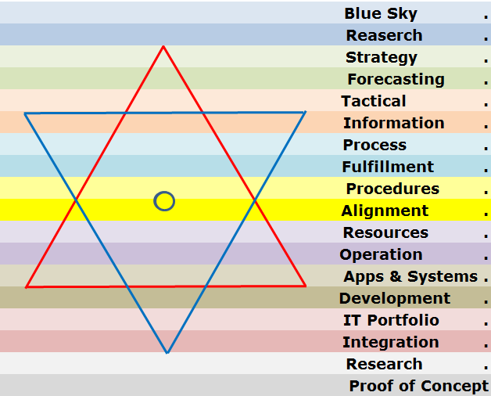
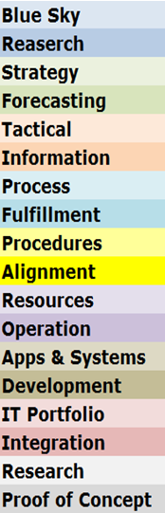
By understanding the maturity you can do things right first time
Cost and effort increase from the centre outwards, and weaknesses in the rows between the centre and the point of delivery will cause failures that cost rework, or extra effort, to mature (permanent) or bridge (temporary, to be removed)
1. Forecasting figures are incorrect.
Each of the blue bubbles have recurring costs if not done, and once-off costs to do
2. The fulfilment of a procedure has been found to be the root cause
5. With this insight the End-to-End Process must be evaluated by establishing what is not in place between the Fulfilment and the end-to-end process and maturing it
3. To fix this, the procedure must be re-evaluated by establishing what is not in place between the Procedure and the Alignment to Enabling Functions and maturing it
4. With this insight the fulfilment must be evaluated by establishing what is not in place between the Procedure and the Fulfilment and maturing it
51

Slide 52
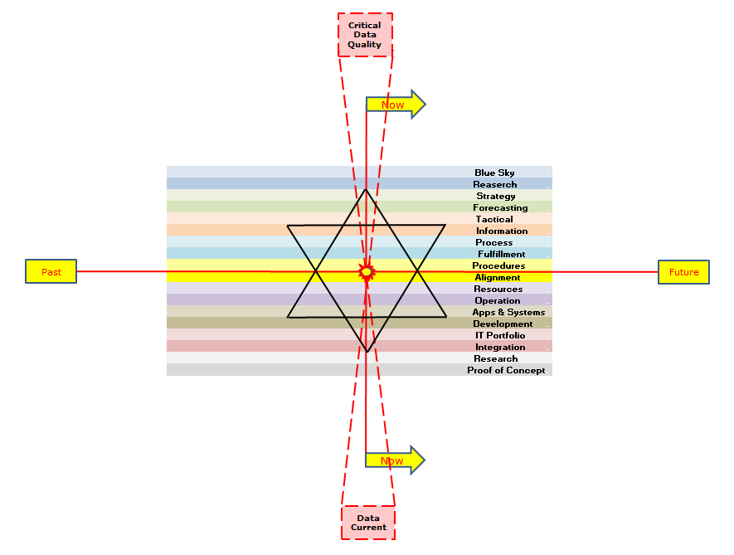

What do I want to do with the object I am thinking about?
The Object must be understood to be moving along the X axis going into the future and leaving a trail of history behind it
The Governance, Control, Measurement and Management, must remain relevant to the time that the object was in, is now in, and will be in in the future
The Object must be understood to be moving along the X axis going into the future and leaving a trail of history behind it
The Object must be understood to be moving along the X axis going into the future and leaving a trail of history behind it
The Object must be understood to be moving along the X axis going into the future and leaving a trail of history behind it
The overlap must keep the Records, Plans, Governance, Control, Measurement & Management aligned and relevant to one another at the different points in time.
The Usefulness, Effectiveness, Efficiency and Functionality of the object must have records for the past, the current state as well as plans for the future
52

Slide 53
What do I want to do with the object I am thinking about?
The Object must be understood to be moving along the X axis going into the future and leaving a trail of history behind it
What do I want to achieve with this object?
The Object must be understood to be moving along the X axis going into the future and leaving a trail of history behind it
The Object must be understood to be moving along the X axis going into the future and leaving a trail of history behind it
The Object must be understood to be moving along the X axis going into the future and leaving a trail of history behind it
What time related issue is most important?
53

Slide 54
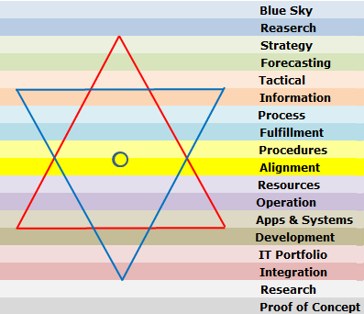
Object Management Considerations
Now
Now
54

Slide 55
Object Execution Guidance Considerations
This Triangle =
Vision, Mission, Strategies, Strategy Measurement, Strategy Execution,
Tactical Management
The triangle consists of information that is not yet valid. It is supposed or expected, but not yet true. Strategies often refer to what is forecasted. Strategies need to have review dates, as the information they were based on can sometimes either not materialise, or become really old, and execution is based on a reality that does not exist. Execution of such strategies causes serious breaches in what is going on in reality
Now
The triangle consists of information that is no longer valid, i.e. it is in the past, however, it is very important to understand the decisions taken at that point in time when the dot was in line with the decision vertically. Knowing why you took decisions in the past can help understand whether a new decision should or should not be taken
Now
55

Slide 56
Object Execution Considerations
This Quadrangle =
the Execution of the Strategies
This top Line =
The Management Line into Tactical Management and the Report Delivery back out of the Execution Function
Now
This right line = The Management Line into Execution Research and the Report Delivery back into the Execution Function
This left line = The Management Line into Execution Archives and the Report Delivery back into the Execution Function
This middle line = The Management of the Execution at the moment when the object interacts with it’s environment
The Execution Function has a component that deals with after the actual interaction of the object on its environment
The Execution Function has a component that deals with before the actual interaction of the object on its environment
This bottom Line =
The Management Line into Execution Enablement and the Report Delivery back into the Execution Function from the Enabling Functions
Now
56

Slide 57
Object Enablement Considerations
This Quadrangle =
the Enabling of the Execution of the Strategies
This top Line =
The Management Line from Execution Enablement and the Report Delivery back into the Execution Function from the Enabling Function
Now
This right line = The Management Line into Enablement Research and the Report Delivery back into the Enablement Function
This left line = The Management Line into Enablement Archives and the Report Delivery back into the Enablement Function
This middle line = The Management of the Execution at the moment when the object interacts with it’s environment
The Enablement Function has a component that deals with before the actual interaction of the object on its environment
The Enablement Function has a component that deals with after the actual interaction of the object on its environment
This bottom Line =
The Management Line into Enablement Assurance and the Report Delivery back into the Enablement Function from the Assurance Functions
Now
57

Slide 58
Object Execution & Enablement Alignment Considerations
This Quadrangle = The Execution Function component that deals with before the actual interaction of the object on its environment
These right lines = the gradient of Execution and Enablement Requirements for Research to be sourced and when it should be sourced. The following shows Gradient Alignment of the two Quadrangles:
Enablement of the
  Execution Function
Alignment of
  Procedures
Enables Resources
  to Fulfil
The Operation of
  the Process
Creating Information
  via Apps & Systems
Research to be able to Enable and Execute must be complementary or the disjointed Research will cause the object to fail to deliver when it interacts with it’s environment.
These right lines = the gradient and alignment between both Execution’s and Enablement’s Requirements for Research to be sourced, as well as when it should be sourced.
The following shows Gradient Alignment of the two Quadrangles:
Enablement of the
  Execution Function
Alignment of
  Procedures
Enables Resources
  to Fulfil
The Operation of
  the Process
Creating Information
  via Apps & Systems
Research to be able to Enable and Execute must be complementary or the disjointed Research will cause the object to fail to deliver when it interacts with it’s environment.
Now
This middle Line =
The Management Line from Execution to Enablement Preparing all the functions Synchronously
The Enablement Function has a component that deals with before the actual interaction of the object on its environment
Now
58

Slide 59
Object Execution & Enablement Alignment Considerations
These left lines = the gradient and alignment between both Execution’s and Enablement’s Requirements for Archiving requirements, as well as when it should be sourced.
The following shows Gradient Alignment of the two Quadrangles:
Enablement of the
  Execution Function
Alignment of
  Procedures
Enables Resources
  to Fulfil
The Operation of
  the Process
Creating Information
  via Apps & Systems
Archiving to Enable and Execute the provision of capacity for effectiveness and efficiency the next time the Object Interacts with it’s environment must be complementary or the disjointed Archiving will cause the object to fail to provide recoverable value when it interacts with it’s environment.
This Quadrangle = The Execution Function component that deals with after the actual interaction of the object on its environment
These left lines = the gradient and alignment between both Execution’s and Enablement’s Requirements for Archiving requirements, as well as when it should be sourced.
The following shows Gradient Alignment of the two Quadrangles:
Enablement of the
  Execution Function
Alignment of
  Procedures
Enables Resources
  to Fulfil
The Operation of
  the Process
Creating Information
  via Apps & Systems
Archiving to Enable and Execute the provision of capacity for effectiveness and efficiency the next time the Object Interacts with it’s environment must be complementary or the disjointed Archiving will cause the object to fail to provide recoverable value when it interacts with it’s environment.
Now
This middle Line =
The Management Line from Execution to Enablement Preparing all the functions Synchronously
The Enablement Function has a component that deals with after the actual interaction of the object on its environment
Now
59

Slide 60

Object Enablement Growth Considerations
The triangle consists of Development Code, Design Methods, Integration Thinking, based on past ways of work, i.e. it is no longer valid, however, As this is part of the current complex Reality, it is very important to understand why what was created, was created. For only when the reason what was created is no longer valid, and not directly, or indirectly in use, can the old be considered for change. The decisions taken at that point in time when the dot was in line with the decision vertically.
This Quadrangle = The Enabling Function component that deals with after the actual interaction of the object on its environment
This Quadrangle = The Enabling Function component that deals with before the actual interaction of the object on its environment
Now
The triangle consists of plans to implement and integrate new things currently being developed, or developed, still to be integrated into what is already in place. Although Execution and Enablement sit between Purpose Assurance and Strategy, these two must be appraised of one another at all times to ensure Strategies can be realised timeously.
This Triangle =
Purpose Assurance,
Reality Reconstruction
Interconnectedness,, Meaning & Value Transfer,
Now
60

Slide 61
Object Execution Research Considerations
This left line of the Triangle (and right line of the Quadrangle) = The Management Line where Research Delivery is requested from Execution Research by The Execution Function component that deals with before the actual interaction of the object on its environment
This right line = the gradient of Execution Research, where information on its own has little value if not contextualised by the Process that requires the Information, it’s Purpose, as well as what Procedures need to be in place and how these will be executed on, to fulfil the Process. Researching all of these is expensive, therefore these should be researched in a manner where the Research over time describes the interrelation of the Procedures, their Fulfilment, of the Process to generate the Information Required.
This Triangle =
Execution of Research
Now
This Quadrangle = The Execution Function component that deals with before the actual interaction of the object on its environment
This Triangle =
Enablement of Research
Now
61

Slide 62

Object Enabling Archiving Considerations
This left line = the gradient of Archiving of what is stored and for how long. The following shows Gradient Alignment of the two Triangles:
Enablement of the
  Execution Function
Alignment of
  Procedures
Enables Resources
  to Fulfil
The Operation of
  the Process
Creating Information
  via Apps & Systems
Storing all of these is expensive, therefore, these should be stored in a manner where the above records remain related and can be decoupled and removed Synchronously over time.
This Quadrangle = The Enabling Function component that deals with after the actual interaction of the object on its environment
Now
This right line of the Triangle (and left line of the Quadrangle) = The Management Line
where Report Delivery Enablement is requested from Enabling Archives by The Enabling Function component that deals with after the actual interaction of the object on its environment
This Triangle =
Enabling of Archiving
Now
62

Slide 63
Object Enabling Research Considerations
This left line of the Triangle (and right line of the Quadrangle) = The Management Line
where Research Delivery Enablement is requested from Enabling Research by The Enabling Function component that deals with before the actual interaction of the object on its environment
This right line = the gradient of Research to be sourced and when it should be sourced. The following shows Gradient Alignment of the two Triangles:
Enablement of the
  Execution Function
Alignment of
  Procedures
Enables Resources
  to Fulfil
The Operation of
  the Process
Creating Information
  via Apps & Systems
Researching all of these is expensive, therefore, these should be researched in a manner where the above remain related and can be researched and added Synchronously over time.
This Triangle =
Execution of Research
Now
This Quadrangle = The Enabling Function component that deals with before the actual interaction of the object on its environment
This Triangle =
Enablement of Research
Now
63

Slide 64
Object Execution & Enablement Control Considerations
This Blue triangle = EFFECTIVENESS OF THE OBJECT:
the translation of
Guidance Controls
to ensure that the object
interacts appropriately
with it’s environment
Alignment of Controls:
Enablement of the
  Execution Function
Alignment of
  Procedures
Enables Resources
  to Fulfil
The Operation of
  the Process
Creating Information
  via Apps & Systems
Now
This Blue triangle =
EFFICIENCY OF THE OBJECT:
the translation of
Enablement Controls
to ensure the Object
Is able to interact
with it’s Environment
These Blue triangles
Have corresponding Guidance and Enablement Controls.
These two sets of Controls must be integrated and intercommunicating,
otherwise the object, is failing by:
1. Efficiently delivering the wrong result.
2. Effectively guided, but delivering nothing.
Please note that 2 is better than 1 as there is no rework
Now
64

Slide 65
Object Interaction Considerations
IMPACT
To the left of the “Now” line indicates the past, after the object has interacted on it’s environment
OPPORTUNITY
To the right of the “Now” line indicates the future, before the object has interacted on it’s environment
Now
These areas show
Impact on EFFECTIVENESS
These areas provide
Opportunity to change EFFECTIVENESS
These areas show
Impact on
EFFICIENCY
These areas provide
Opportunity to change
EFFICIENCY
SUCCESS
Each Triangle (management area) must define:
1. What happens on each row in their triangle.
2. Which rows affect their effectiveness and efficiency.
3. Which Triangles & Quadrangles are responsible for these rows.
4. Which Business Units/People are Key role players to connect with to resolve issues .
Now
65

Slide 66
Object Object Action Considerations
EFFECTIVENESS OPPORTUNITY Define this for each quadrangle created by the row lines the “Now” & the dotted line
Choose your Critical Requirement for when the Object acts on it’s environment.
NB!! No other insights be considered until this is defined.
NBNBNB!!! If you change this, then you have to start the whole focus analysis from the beginning
Critical to
Act
Now
EFFECTIVENESS IMPACT
Define this for each quadrangle created by the row lines the “Now” & the dotted line
EFFICIENCY OPPORTUNITY
Define this for each quadrangle created by the row lines the “Now” & the dotted line
EFFICIENCY IMPACT
Define this for each quadrangle created by the row lines the “Now” & the dotted line
This explains the stage in the object’s lifecycle, that pertains to the functioning of the object
Use
Stage 0
66

Slide 67
Object Opportunity Preparation Considerations
Critical to
Act
Using your Critical Focus Point
EFFECTIVENESS OPPORTUNITY Define this for each quadrangle created by the row lines the & the dotted lines
Required
to be prepared
Now
Identify what is meant by “being prepared”
Determine what could work better if prior Preparation work was done.
Remember this includes:
Inter-communication, Management,
Controls,
Current Effectiveness, Current Efficiency,
Potential impact on current situation
What will you lose?
What will you gain?
EFFICIENCY OPPORTUNITY
Define this for each quadrangle created by the row lines the & the dotted lines
Use
Stage 0
Life Cycle
Stage -1
Determine the Preparation stage of the Object’s Lifecycle and list it.
67

Slide 68
Object Opportunity Pre-preparation Considerations
Critical to
Act
Using your Critical Focus Point
Required
to be prepared
EFFECTIVENESS OPPORTUNITY
Establish a Functional Capability that maintains Interactive Preparation to ensure the Object Interacts Effectively
Determine what could work better if prior Preparation work was done.
Remember this includes:
Inter-communication, Management,
Controls,
Current Effectiveness, Current Efficiency,
Potential impact on current situation
What will you lose?
What will you gain?
Now
EFFICIENCY OPPORTUNITY
Establish a Functional Capability that maintains Interactive Preparation to ensure the Object Interacts Efficiently
Use
Stage 0
Life Cycle
Stage -1
Determine the Preparation stage of the Object’s Lifecycle and list it.
68

Slide 69
Object Opportunity Pre-preparation Considerations
Critical to
Act
Using your Critical Focus Point
EFFECTIVENESS OPPORTUNITY Define this for each quadrangle created by the row lines the & the dotted lines
Required
to be prepared
Medium Term
Planning / Preparation
Now
Identify what is meant by “Medium Term”
Determine what could work better if prior Preparation work was done.
Remember this includes:
Inter-communication, Management,
Controls,
Current Effectiveness, Current Efficiency,
Potential impact on current situation
What will you lose?
What will you gain?
EFFICIENCY OPPORTUNITY
Define this for each quadrangle created by the row lines the & the dotted lines
Use
Stage 0
Life Cycle
Stage -1
Life Cycle
Stage -2
Determine this stage of the Object’s Lifecycle and list it.
69

Slide 70
Object Opportunity Pre-preparation Considerations
Critical to
Act
Using your Critical Focus Point
Required
to be prepared
Medium Term
Planning / Preparation
EFFECTIVENESS OPPORTUNITY
Establish a Functional Capability that maintains Interactive Preparation to ensure the Object Interacts Effectively
EFFECTIVENESS OPPORTUNITY
Establish a Functional Capability that maintains Interactive Preparation to ensure the Object Interacts Effectively
Determine what could work better if prior Preparation work was done.
Remember this includes:
Inter-communication, Management,
Controls,
Current Effectiveness, Current Efficiency,
Potential impact on current situation
What will you lose?
What will you gain?
Now
EFFICIENCY OPPORTUNITY
Establish a Functional Capability that maintains Interactive Preparation to ensure the Object Interacts Efficiently
EFFICIENCY OPPORTUNITY
Establish a Functional Capability that maintains Interactive Preparation to ensure the Object Interacts Efficiently
Use
Stage 0
Life Cycle
Stage -1
Life Cycle
Stage -2
Determine this stage of the Object’s Lifecycle and list it.
70

Slide 71
Object Opportunity Research Considerations
Critical to
Act
Using your Critical Focus Point
EFFECTIVENESS OPPORTUNITY Define this for each quadrangle created by the row lines the & the dotted lines
Required
to be prepared
Medium Term
Planning / Preparation
Long Term
Planning / Preparation
Now
Identify what is meant by “Long Term”
Determine what could work better if prior Research was done.
Remember this includes:
Inter-communication, Management,
Controls,
Current Effectiveness, Current Efficiency,
Potential impact on current situation
What will you lose?
What will you gain?
EFFICIENCY OPPORTUNITY
Define this for each quadrangle created by the row lines the & the dotted lines
Use
Stage 0
Life Cycle
Stage -1
Life Cycle
Stage -2
Life Cycle
Stage -3
Determine this stage of the Object’s Lifecycle and list it.
71

Slide 72
Object Opportunity Research Considerations
Critical to
Act
Using your Critical Focus Point
Required
to be prepared
Medium Term
Planning / Preparation
Long Term
Planning / Preparation
Determine what could work better if prior Research was done.
Remember this includes:
Inter-communication, Management,
Controls,
Current Effectiveness, Current Efficiency,
Potential impact on current situation
What will you lose?
What will you gain?
EFFECTIVENESS OPPORTUNITY
Establish a Functional Capability that maintains Interactive Preparation to ensure the Object Interacts Effectively
Now
EFFICIENCY OPPORTUNITY
Establish a Functional Capability that maintains Interactive Preparation to ensure the Object Interacts Efficiently
Use
Stage 0
Life Cycle
Stage -1
Life Cycle
Stage -2
Life Cycle
Stage -3
Determine this stage of the Object’s Lifecycle and list it.
72

Slide 73
Object Impact Preparation Considerations
Required
for reuse
Critical to
Act
Using your Critical Focus Point
EFFECTIVENESS IMPACT
Define this for each quadrangle created by the row lines the & the dotted lines
Identify what is meant by “reuse”
Determine what could work better if prior Impact was understood, expected and could be Prepared for.
Remember this includes:
Inter-communication, Management,
Controls,
Current Effectiveness, Current Efficiency,
Potential impact on current situation
What will you lose?
What will you gain?
Now
EFFICIENCY IMPACT
Define this for each quadrangle created by the row lines the & the dotted lines
Life Cycle
Stage 1
Use
Stage 0
Determine this stage of the Object’s Lifecycle and list it.
73

Slide 74
Object Impact Preparation Considerations
Required
for reuse
Critical to
Act
Using your Critical Focus Point
EFFECTIVENESS IMPACT
Establish a Functional Capability that maintains Interactive Preparation to ensure the Object Interacts Effectively
Determine what could work better if prior Impact was understood, expected and could be Prepared for.
Remember this includes:
Inter-communication, Management,
Controls,
Current Effectiveness, Current Efficiency,
Potential impact on current situation
What will you lose?
What will you gain?
EFFICIENCY IMPACT
Establish a Functional Capability that maintains Interactive Preparation to ensure the Object Interacts Efficiently
Now
Life Cycle
Stage 1
Use
Stage 0
Determine this stage of the Object’s Lifecycle and list it.
74

Slide 75
Object Impact Analysis & Intelligence Considerations
Medium Term
Analysis & Intelligence
Required
for reuse
Critical to
Act
Using your Critical Focus Point
EFFECTIVENESS IMPACT
Define this for each quadrangle created by the row lines the & the dotted lines
Identify what is meant by “Medium Term”, “Analysis” & “Intelligence”
Determine what could work better if analysis & Intelligence requirements were understood & met.
Remember this includes:
Inter-communication, Management,
Controls,
Current Effectiveness, Current Efficiency,
Potential impact on current situation
What will you lose?
What will you gain?
Now
EFFICIENCY IMPACT
Define this for each quadrangle created by the row lines the & the dotted lines
Life Cycle
Stage 2
Life Cycle
Stage 1
Use
Stage 0
Determine this stage of the Object’s Lifecycle and list it.
75

Slide 76
Object Impact Analysis & Intelligence Considerations
Medium Term
Analysis & Intelligence
Required
for reuse
Critical to
Act
Using your Critical Focus Point
EFFECTIVENESS IMPACT
Establish a Functional Capability that maintains Interactive Preparation to ensure the Object Analysis & Intelligence is accurate and useful
EFFECTIVENESS IMPACT
Establish a Functional Capability that maintains Interactive Preparation to ensure the Object Analysis & Intelligence is accurate and useful
Determine what could work better if Analysis & Intelligence Requirements were understood, expected and could be Prepared for.
Remember this includes:
Inter-communication, Management,
Controls,
Current Effectiveness, Current Efficiency,
Potential impact on current situation
What will you lose?
What will you gain?
EFFICIENCY IMPACT
Establish a Functional Capability that maintains Interactive Preparation to ensure the Object Analysis & Intelligence is accurate and useful
EFFICIENCY IMPACT
Establish a Functional Capability that maintains Interactive Preparation to ensure the Object Analysis & Intelligence is accurate and useful
Now
Life Cycle
Stage 2
Life Cycle
Stage 1
Use
Stage 0
Determine this stage of the Object’s Lifecycle and list it.
76

Slide 77
Object Impact Analysis & Intelligence Considerations
Long Term
Historical
Medium Term
Analysis & Intelligence
Required
for reuse
Critical to
Act
Using your Critical Focus Point
EFFECTIVENESS IMPACT
Define this for each quadrangle created by the row lines the & the dotted lines
Determine what could work better if Historical Requirements were understood and met.
Remember this includes:
Inter-communication, Management,
Controls,
Current Effectiveness, Current Efficiency,
Potential impact on current situation
What will you lose?
What will you gain?
Identify what is meant by “Historical”
Now
EFFICIENCY IMPACT
Define this for each quadrangle created by the row lines the & the dotted lines
Life Cycle
Stage 3
Life Cycle
Stage 2
Life Cycle
Stage 1
Use
Stage 0
Determine this stage of the Object’s Lifecycle and list it.
77

Slide 78
Object Impact Analysis & Intelligence Considerations
Long Term
Historical
Medium Term
Analysis & Intelligence
Required
for reuse
Critical to
Act
Using your Critical Focus Point
EFFECTIVENESS IMPACT
Establish a Functional Capability that maintains Interactive Preparation to ensure the Object History is accurate and useful
Determine what could work better if Historical Requirements were understood and met.
Remember this includes:
Inter-communication, Management,
Controls,
Current Effectiveness, Current Efficiency,
Potential impact on current situation
What will you lose?
What will you gain?
EFFICIENCY IMPACT
Establish a Functional Capability that maintains Interactive Preparation to ensure the Object History is accurate and useful
Now
Life Cycle
Stage 3
Life Cycle
Stage 2
Life Cycle
Stage 1
Use
Stage 0
Determine this stage of the Object’s Lifecycle and list it.
78

Slide 79
MDDMF v1.0 Initial unpacking (2010-2012)
End of MDDMF Version 1.0
  Click to Return

Slide 80
MDDMF v2.0 Alignment to DMBOK1 (2012-2016)
William Certified as a CDMP (Data Governance and Data Quality) in 2012-06
Applied the Framework within a Telco in South Africa, where he met Anna Moreira, and Herman Badenhorst of Edge
Included alignment of DAMA DMBOK1 Data Disciplines, aligned to the Version 1.0 2D Graphic received in 2010
Affectionately known as “The Data Atom”, was presented at DAMA Conference in South Africa, 2015-07-28.
  Click to Return

Slide 81
2. The Information Value Chain in your Enterprise
Please email all queries to Herman.Badenhorst@edgedatawave.co.za,
- Start your message with:
- The company name you are representing;
- followed by your name;
- followed by your email address;
- followed by a message title (I will need context to understand the question); and
- followed by your question.
Answering of questions received during this workshop, AND which are pertinent to this workshop topic is free, only if submitted and received during this workshop.
Answers may be given during or after the workshop, or over the next few days. You are also welcome to engage me for training and consulting.

Slide 82
Understand the data flow through the Information Value Chain
Understand the data flow through the Information Value Chain
Information Value Chain
Silos created through lack of end-to-end process Map.
Business areas fulfil KPAs and KPIs in isolation of one another, destroying one another’s efficiency capabilities
Build end-to-end process Map “Gauteng Road Map Book” Concept.
All Business areas fulfil KPAs and KPIs synchronously with each other, strengthening one another’s efficiency capabilities
Business Direction
Data is an
Enterprise
Asset
And must
Flow
Business Run
Business Enabled
Notes:
The words should be seen as segments of a hosepipe where the segment below supplies the Business needs of the segment above. These can be broken into 3 segments: Business Direction, Business Run and Business Enablement.
Just as water flowing quickly through a muddy river, has brown cloudy water, and water flowing through glass pipes will be crystal clear, it is the environment that data travels through that determines its quality.
Each of these segments have a different set of forces causing poor data quality, and each needs to be understood, measured and managed. It is therefore unreasonable to blame the Applications and Systems Segment for poor data quality, when the Enterprise does not have a single map of their End-to-End Processes. Processes such as “Order-to-Cash” or “Hire-to_Retire”, each with empowered and financed Process Owners.
The “Information Value Chain” is a term we use for this flow through these segments, and while data is a continuous flow (counter-clockwise) it must be managed continuously based on the source of where that data is emanating from (clockwise)
Business Connexion was referred by KID as a flagship of a mature enterprise into which Master Data Management as a Business capability could be easily introduced. At the SAPHILA Conference of 2012, BCX was asked to present their success and noted the critical success factors for implementing a successful MDM solution. All of these rely on maturing the different segments of the Information Value Chain.

Slide 83
3. Enterprise Architectures across Information Value Chain segments
Please email all queries to Herman.Badenhorst@edgedatawave.co.za,
- Start your message with:
- The company name you are representing;
- followed by your name;
- followed by your email address;
- followed by a message title (I will need context to understand the question); and
- followed by your question.
Answering of questions received during this workshop, AND which are pertinent to this workshop topic is free, only if submitted and received during this workshop.
Answers may be given during or after the workshop, or over the next few days. You are also welcome to engage me for training and consulting.

Slide 84
Enterprise Architecture Triangle
1
Business
Processes
Terms & Definitions
Resources
Notes:
The Circle in the centre of the model is any object you choose to be placed under scrutiny. If you want to make the object the “Customer”, or a “specific Product”, or maybe a “Role you are defining in your organisation. You can focus on a particular Business Capability, or you can make this a particular system or Application. In fact the model is so generic you could use it for your own car.
The Apex-Up Triangle refers to the Traditional Enterprise Architecture triangle, however, when aligned to the Information Value Chain, a more granular flow of data is observed to be running through the Enterprise.

Slide 85
Service Oriented Architecture
1
Business Processes
Data Objects
Services
Technology
Notes:
About three years ago I came across Shawn Simon (Oshyn Powering Innovation)’s graphical representation of Service Oriented Architecture, which he describes in his Article on “SOA Turning things Upside Down”. (http://oshyn.com/soa/soa-turning-things-upside-down )
Over the many years of running IT systems, new data sources and data flows are created, without decommissioning the old ones. Often this is because there is little or no records or understanding of who or what else may be using these data flows. While Businesses restructure regularly, applications and systems are expected to take on new roles and provide new capabilities. This simply keeps adding complexity to data flows, and inaccuracies over time as semantics and terminology and definitions change. Eventually the IT system(s) has become a tangled ball of wool that tightens the knots with every new Business Request. (Restructures causing loss of IP only makes matters more unrecoverable)
SOA was thought to be the solution, however, simply rebuilding services based on the current mess of antiquated and no longer used (but still supplied) Business Integration Requirements creates duplication of effort, a plethora of conflicting services and servicing rules, and maintains waste of storage, bandwidth, performance, etc...
The CDO must drive the rationalisation of Business Terms and Definitions, which serves to expose duplicated Business Processes, originally considered to be different, but when confusing and ambiguous terms are rationalised, there may be one process, with minor tweaks required to service everyone’s needs. This leads to singular, Enterprise-Wide Definition of Data Objects which are reduced in complexity and devoid of confusion and ambiguity. With rationalised Data objects comes a far simpler set of easily manageable services from a rationalised set of data sources to service the real Business needs. This in turn means data flows are lifted out of legacy technologies, and these can be taken to cheaper resources, and finally archived.

Slide 86
Enterprise Architecture
Understand data touch points between EA and Information Value Chain Segments
How the Architectures work together
ENTERPRISE
DATA
ARCHITECTURE
Enterprise
Business Architecture
Business
Information
Reporting Architecture
Process
Process Architecture
Operations
Delivery
Architecture
Resources
Application
Information Technology Architecture
Infrastructure
Enterprise
Notes:
Speaking of Architectures (Remember that these are simply the maps that show where everything is, how it is connected, and what enables what to work. If there is no true accurate architecture, there will always be unintended negative consequences.
Enterprise Architecture focuses on ensuring value is derived from Innovation and Proof of Concepts, however, they also integrate all the other Architectures.
Business Architecture works very closely with Enterprise Architecture, and owns the Business Value Chain(s) and Business Capability Models.
Information Architecture (sometimes referred to as Reporting Architecture) shows how the needs of the Business for Information are met and from which sources.
Process Architecture focuses on the End-to-End Business Processes that support the Business value Chain, linking the Business Procedures to one another in a single integrated map of interactivity.
Operations Architecture is the actual Work Instructions and Procedures that make the Business Work (For humans in human language, and for systems in programming code and signal configuration). This is where data quality is usually assumed to be perfect, and usually data quality problems cause ever-widening circles of unintended consequences impacting business Value. Data Quality is a core function.
Resources Architectures focus on all resources, owned and non-owned, be they human resources, information, technology resources or raw or processed materials. For each of these resources, there are one or more roles, and for each role there is an expectation to receive semantically correct quality data, for them to fulfil their function and generate semantically correct quality output for the next resource in the procedure to use.
Application Architectures focuses on any tool used for a purpose. Typically we think of software IT Applications and Systems, which must be fit-for-purpose, and must receive good quality data, that meets the semantic definition expected by the creators of the Application/system, to deliver a correct result for resources to use.
Infrastructure Architectures focuses on the IT Hardware, configuration, routing, scaling and performance of data

Slide 87
Service Oriented Architecture
Understand data touch points between SOA and Information Value Chain Segments
ENTERPRISE
DATA
ARCHITECTURE
Enterprise
1. Business Value Chain
Business
2. Business Capabilities
Information
3. Reporting Rationalised
Process
4. Procedures Rationalised
Operations
5. Tasks Rationalised
Resources
6. Data Rationalised
Application
7. Data Flows Rationalised
Infrastructure
8. Simplified Effective SOA
Enterprise
Notes:
The various Architectures need to interact with one another and properly unite and integrate their different catalogues and models to be able to perform a “data-protected” IT Application and systems restructure to remove the dead-wood legacy applications, while maintaining the Enterprise’s ability to deliver on its daily requirements.
Business Functions must properly define their Business Value Chains, selecting the Business Capabilities already defined by Business Architecture to ensure they can still deliver. (Unused Business Capabilities can be scrapped or sold off). Only reporting for required Business capabilities must be kept, and these must be modularised and data driven to support different functions. Only procedures which drive the Business Value Chains (HR is of itself a Value chain even if it does not generate an Income) must be kept and all reporting must be re-evaluated based on the new business requirements.
Often tasks are performed for no apparent reason. Sometimes it is because downstream somewhere, this information is critical and collection at this task is ideal, in which case keep it, and sometimes it was done because a long time ago someone needed it, but it is no longer required (beware of scrapping tasks used to support long-running cycles, e.g. annual reporting)
Reducing tasks, almost always reduces confusion and ambiguity as terms and definitions drop off the requirements list. This also simplifies the Data Object Models.
Map all the data flows and Identify obsolete data flows based on identifying which data no longer adds value to the value chains. Ensure that these data flows are not conduits for transferring data to different Business Processes elsewhere in the Business. If they do identify the data to be moved via a service before decommissioning the Data Flow.
Now it is possible to build SOA Services intelligently, and to a rationalised set of Business Process es requiring the data. Management of the reduced data flows also becomes less error-prone, creating less unintended errors and consequences, which simply create more fires to fight.

Slide 88
4. Time, Control, Delivery, Cost & Effort Considerations
Please email all queries to Herman.Badenhorst@edgedatawave.co.za,
- Start your message with:
- The company name you are representing;
- followed by your name;
- followed by your email address;
- followed by a message title (I will need context to understand the question); and
- followed by your question.
Answering of questions received during this workshop, AND which are pertinent to this workshop topic is free, only if submitted and received during this workshop.
Answers may be given during or after the workshop, or over the next few days. You are also welcome to engage me for training and consulting.

Slide 89
Cost and Effort Architectures
1
NOW
Past
Future
NOW
Notes:
So far we have discussed the Business, its Architectures and data as it flows and services the Enterprise’s needs. However, The Chief Data Officer’s accountability extends way beyond the data and its use within the business.
The CDO must consider and remain the steward over data that would be used by the business, as well as data already used by the Business, which introduces the dimensions of time indicated by the red lines crossing in the centre of the model.
This model now becomes a living moving model, as the yellow circle (that which you have chosen to be the object under your focus) must be seen to be continuously moving from left to right, with the focus circle being at the intersection and being the immediate moment of now. In fact along the entire Information Value Chain there will always be an identical moment in time referenced across each segment as being the moment “NOW” (or this instant in time).
The other 8 intersecting lines radiate outwards from the intersection and divide the subject under focus into time sections. The further we move in any direction away from the center, the greater the cost and effort of attaining and maintaining data in this dimension. Therefore it is essential to achieve a sustainable maturity before reaching for “low hanging fruit” in segments beyond current real appetite to consume. The expanding distance between the lines as you move from the centre indicate the tolerances for data quality (expensive) as a trade off against the purpose for which the data is being used (the Info Value Chain segment it is in)
The second important observation is that the intersection and in fact the object under focus rests on the line between “Alignment” and “Procedure”. “Alignment” means I have definition of everything I have at my disposal, and “Procedure” means I have one or more activities that I will be performing using what I have.
For the CDO, everything goes wrong when anyone can decide what definition to apply at any point in a procedure. The CDO must therefore own the Terms and Definitions across the Enterprise and enforcement of correct use is everyone’s responsibility.

Slide 90
Time Architecture
1
NOW
Past
Future
NOW
Notes:
The concept of time has been discussed, however the Architecture of time must be understood. Time Architecture is entirely dependant on the object under focus. For example people refer to a dog as living 7 years for every one of their own. Time relativity is therefore dependant on the lifespan of the object under focus.
In terms of data, we know that certain data may not be destroyed until a certain number of years has passed since it was last used. So if we have “Customer” as our focus, we can set our furthest blue line to the left to a time span of 15 years (depends on your industry)
The 2 next segments moving to the right are then when to stop keeping the data (and resources) available at low performance or at high performance, and the segment closest to the “Now” line is data currently in use, and in the process of being continuously re-used (Data Quality permitting).
The furthest to the right line indicates when the first time you would want insight into the need for a new attribute for a customer object. This requires significant research effort in where the world is going, and where technology is going to understand the usefulness of such data. The CDO’s Visionaries would work in this space.
The 2 lines in between when it would be ideal to have data prepared and ready for use (Master Data Management falls into the second leading-edge segment, while the 3rd leading edge segment includes Reference Data and Meta-data as these are easier to implement, requiring less maturity to maintain accurately.
The segment closest to the now line indicates that which one must have to fulfil the immediate requirements of the here and now” activities.

Slide 91
MDDMF v2.0 Initial unpacking (2012-2016)
End of MDDMF Version 2.0
  Click to Return

Slide 92
MDDMF v3.0 Alignment to DMBOK2 (2017-2018)
William Re-Certified as a DAMA CDMP
Applied the Framework within his own Business, working on multiple contracts
Included alignment of DAMA DMBOK2 Data Disciplines, aligned to the Version 1.0 2D Graphic received in 2010
Named the Multi dimensional Data Management Framework.
Highlighted the missing Definition Management Components
Presented at various CDO & CDAO Conferences (as a presentation/workshop)
  Click to Return

Slide 93
5. Data Governance Structures across Information Value Chain segments
Please email all queries to Herman.Badenhorst@edgedatawave.co.za,
- Start your message with:
- The company name you are representing;
- followed by your name;
- followed by your email address;
- followed by a message title (I will need context to understand the question); and
- followed by your question.
Answering of questions received during this workshop, AND which are pertinent to this workshop topic is free, only if submitted and received during this workshop.
Answers may be given during or after the workshop, or over the next few days. You are also welcome to engage me for training and consulting.

Slide 94
Understand stewardship across Information Value Chain segments
Understand stewardship across Information Value Chain segments
Info & Data
a
b
Governance
c
d
Council
e
Business Value Chain Image
f
g
h
Info & Data
i
j
Stewardship
Council
IT Portfolio Image
k
l
m
Notes:
What needs to be borne in mind is that each of the actors in the Business, already has their own set of understanding and definition. This is a filter that changes incoming data-meaning before passing it on.
At the Strategic and Tactical (Management) levels, driven by Policies and Principles, reporting and dash-boarding are used. But this interaction also includes presentations, word documents, images, video, sound-bites, etc… mostly among humans (This is the segment where the Data Governance Council is most active –Senior Co-ordinating Data Stewards from the segment below also sit on the Data Governance Council – Representing the Data Stewardship Committee)
At the Business Design level of Business Value Chain, End-to-End Processes, and the Procedures that make up the Enterprise, we encounter a level of process management and reporting, design and delivery of the Work Instructions that enable co-ordinated operational processing, including interaction with other human and technological participants in automated Document-flow.
At the Business Delivery level of Terms and Definitions, understanding of Policies, Principles, Processes, Procedures and Work Instructions, as well as correct and appropriate use and understanding of other human as well as technological Resources is the potential failure point. While Operationalisation of Business to fulfil delivery according to Business Design, Data is constantly moving between human and technological software paradigms and it is often at this point where data is inadvertently corrupted through misunderstanding or abuse of either human or technological actors. To maintain the correct understanding, the Business Data Steward must have and control the Only source of True definition of the Enterprise Data Object of “Customer”, “Product”, “Location” etc…
At the Research and Development level of Finding new ways, adjusting to new demands and exposing new value, The Portfolios, and their ability to consume and leverage new inputs becomes key. The Technology Data Stewards ensure that data integrity as per the True Definition will not be compromised by new developments.

Slide 95
Applying the Data Management Data Disciplines
Long Term
Historical
Medium Term
Analysis & Intelligence
Required
for reuse
Critical to
Act
Required
to be prepared
Medium Term
Planning / Preparation
Long Term
Planning / Preparation
Now
Past
Future
Now
Life Cycle
Stage 3
Life Cycle
Stage 2
Life Cycle
Stage 1
Use
Stage 0
Life Cycle
Stage -1
Life Cycle
Stage -2
Life Cycle
Stage -3
95

Slide 96
6. Determine Executive focus across Information Value Chain Segment Metrics
Please email all queries to Herman.Badenhorst@edgedatawave.co.za,
- Start your message with:
- The company name you are representing;
- followed by your name;
- followed by your email address;
- followed by a message title (I will need context to understand the question); and
- followed by your question.
Answering of questions received during this workshop, AND which are pertinent to this workshop topic is free, only if submitted and received during this workshop.
Answers may be given during or after the workshop, or over the next few days. You are also welcome to engage me for training and consulting.

Slide 97
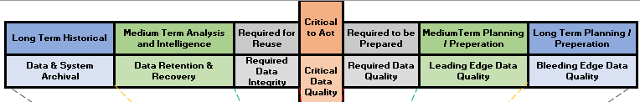
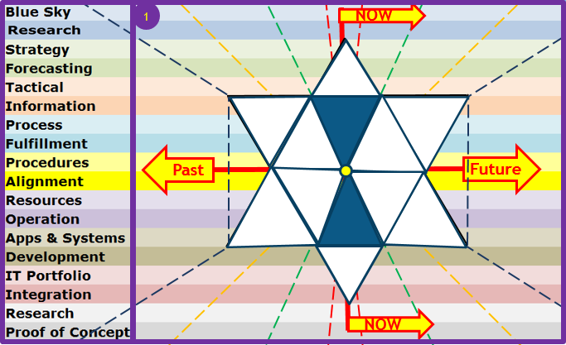

Enterprise Data Architecture
Notes:
A clear distinction needs to be made between a Data Architect, someone who models data from the Subject Area, through the Conceptual, through the Logical and to the Physical representation, and an Enterprise Data Architect which not only models the data architecture in this fashion, but also includes the semantic modelling of data at rest and in flight between and among humans, between and among systems as well as between and among humans and systems, mapping out the full and comprehensive flow of data across the Enterprise. An Enterprise Data Architect is the CDO’s right hand, understanding the Enterprise Data Architecture and providing the insight to drive the various Enterprise Data Management Capabilities and Projects and Initiatives.
Enterprise Data Architecture supports Enterprise Data Governance by defining touch points where meaningful metrics on Data Semantics, Quality, Security, can be measured, and Enterprise Data Architecture supplies Data Governance, with insight into Risks and Issues as well as potential impact of pending decisions. The Chief Data Officer can then identify areas that are mature enough to begin reaping the opportunities that would generate an income from Data in a sustainable and brand-protected manner.
The Enterprise Data Architect therefore goes beyond just the Architectural models, to what is truly happening in the Business, as Quality, Security, and all other Data related Disciplines interact on the same Enterprise Architecture Map.
By adding dimensions to the top, and an approved Life-cycle at the bottom, any area of the Business can use this model to define how their Data is supporting or harming their ability to deliver, immediately, as well as identifying opportunities to mature to levels where they intelligently deliver. Furthermore, identifying missing requirements critical to the successful delivery of a solution or project can also be evaluated by overlaying the maps of the Business, Enterprise Architecture, Solution Architecture, and the Project. This is a far cheaper way of ensuring the Enterprise achieves Benefits Realisation, as apposed to churning out successful projects generating completed deliverables, which ultimately do not meet the Business’s real requirements.

Slide 98
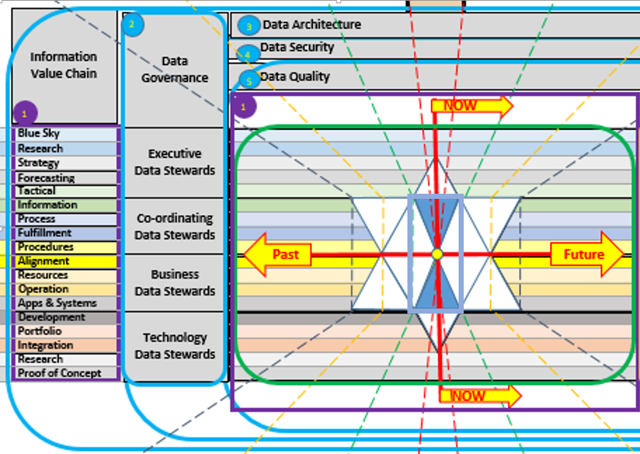
CDO: Core Data Management Disciplines
Notes:
Adding the Core Data Disciplines of Data Governance shows how the different Data Stewards interact with the Business and IT. And the Core Data Disciplines of Architecture, Security and Quality span all time Architectures as well as all Organisational Architectures. A key Data Discipline running to the right of the model, and by implication affects all of the Information Value Chain Segments is the Rationalisation of Confusing and ambiguous Terms and Definitions. You cannot simplify IT, until you remove definition confusion and ambiguity, just like you cannot operate on a person until you remove the opportunity for infection to kill the patient after the “successful” operation.
The Business Segments of the Information Value Chain need to work together very closely within the red box indicated, understanding how their individual actions work together as a unit in preparing for the moment of “Now”, when all the preparation transitions into an action that is fulfilled. Once the fulfilment has taken place, the time after the “Now” moment, is a time of working together to re-use what worked, get smarter about what could be done next time and feed this back to those who are preparing for the next action to be delivered.
The Chief Data Officer uses this model to determine whether the data is capable of meeting the quality requirements to service desired Enterprise Goals or Projects.
One such goal may be monetising of data, another may be providing open-data, another may be signing off on the accuracy of the Annual Reports.
I would hasten to add the following words of caution: Don’t do Agile, if you are “Fragile”, because “Agility” demands the capability of “Stability”. We should not guess or assume we are not fragile, we should measure it and fix where we are lacking.
Finally, this is a great RCA tool to identify root cause as well as where one may expect to experience unintended consequences. Finding and stopping unintended negative consequences reduces the need for “fire-fighting” – It is knowing where to look, and this model guides in that process.

Slide 99
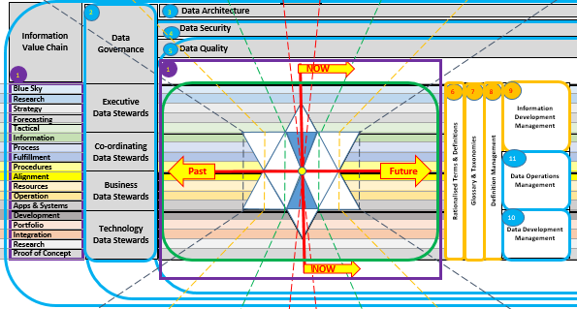
The CDO: “Meaning”
Notes:
As shown in the definition slide, and in slides leading up to this slide, there is no single centralised accountability for Definition in the Enterprise, and yet data is corrupted through ambiguous or confused misinterpretations of the meaning, either by humans, or by humans misunderstanding systems internal definitions, or by humans incorrectly coding programs based on misinterpretations.
The Chief Data Officer is accountable for the correct interpretation being attached to and used consistently throughout the flow of data as it cycles through the Enterprise. The 80/20 rule cannot be applied to data, as data is a closed cycle, where after applying this rule once data has 80% quality, after a second time, this is 80% of the 80% which = 64% quality, and so after 10 iterations of applying this rule (a common misapplication of the Agile process), the data quality is potentially 13% accurate. Would you hire someone who got 13% for their matric exams?
The following functions need to exist and need to work together to rationalise Terms and Definitions, to develop Global as well as specific Industry or occupation related Taxonomies and Glossaries, with the Global Glossary being prefixed with the company name and the balance prefixed with their specific view of the world. This removes the opportunity for ambiguity, even if the terms are the same.
Definition Management works closely with Information Development, where new requests for Information are first checked against existing availability, and where Data Development can be engaged to find or make available data whose definition properly matches the defined requirements for the information sought. Data Operations Management is the ongoing provision of existing data to existing information requirements and defends against attempts to abuse definitions in the quest to have a quick report (“even if it is a little inaccurate”)
It is acceptable for there to be inaccuracies in forecasts, or when test data is being created for Proofs of concepts, and this is why there is a trade-off between the Cost and Effort Architecture and the time Architecture. However, between Apps and Systems and the Information segments of the Information Value Chain, no such trade-off is permitted. It will always sow seeds that become forests of corrupted data.

Slide 100
CHRO: Human “Understanding”
a
b
a
b
Data
c
Governance
d
e
Council
f
g
h
a
Data
b
Stewardship
c
d
Council
e
f
g
h
Notes:
While the CDO is responsible for the actual approved meaning, the CHRO (Chief Human Resources Officer) is accountable for the appointment of the correctly thinking humans and ensuring they are aligned to the frameworks and thought patterns the Enterprise has chosen as its “language”.
Induction of humans must include not only exposure to the Global Glossary, and vocation specific glossaries, (whether they are permanent, contracting or temporary) and tests should be undergone regularly to ensure continuous realignment of human communication to the Enterprise “Single Language”.
Any new terms and definitions must be communicated to and acknowledged by all humans (whether they are permanent, contracting or temporary) if this is vocation specific, then to those associated with that vocation/skill-set, otherwise globally to all working with the Enterprise.
It should be noted that as no company is an island, it is valuable for externally facing humans to be able to relate internal Terms and Definitions to the same Definitions which external customers or providers use. For this reason adoption of an Internationally accepted dictionary is a good practise.
Having a glossary within a document is valuable to capture the language of the day, however, not if this will be abused by allowing unapproved Terms and Definitions to be entered into the “Single Enterprise Language”. Enterprise Terms and Definition Management must provide their seal of approval that the language and terms and definitions used are consistent with the Enterprise’s “Single Enterprise Language”.
The different Data Steward categories are useful at this juncture, and each of the Data Governance stewards needs to be able to represent a vocational area, an industry segment, and all must be able to adjudicate on the Global Terms and Definitions of the Single Enterprise Language, as they are the controls in the workplace and among the people.

Slide 101
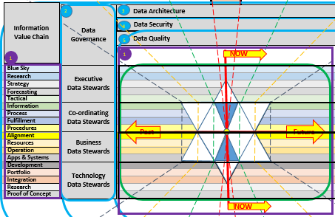
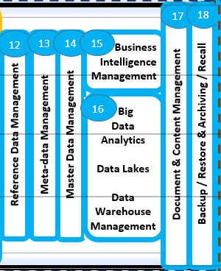
The CIO: “Structure”
Notes:
The CIO is accountable for providing the mechanisms and software tools that allow humans and other external data sources to be captured into a set of Business and Operational tools that provide the business processes with the correct data at the time that is necessary, to be presented as information in the form of combinations of data from various sources.
To achieve this the CIO has to bring on board systems and applications developed in different places of the world, with different mind-sets and cultures, and usually using different terms for the same or similar definitions already used in the Enterprise.
Further to this different Programming languages, and human programers also have their own personal languages and this can easily lead to misdirected actions when IT humans interact with a Business Requirement Specification without the ability to question what is actually meant by the business persons that created it. The Agile methodology of putting this group of people in the same room goes some way to resolving this divide in understanding, however, the different “Agile” initiatives on different projects or as business initiatives are still left to misunderstand one another at the more macro level. The consequence is therefore misunderstanding and confusion at the highest level of the Enterprise.
The CIO must therefore engage their various staff members in contributing to system, Application and programming specific Terms and Definitions, prefixing each with the source of the approved term, and these must each be related to the Definitions that exist in the Global Glossary, or in the specific Industry of vocational glossaries.
To the CIO, the statement to Business is “If you put Garbage-In, we can only give you Garbage-out” is not a statement that should be allowed in any business. By mapping and educating the IT staff on the “Single Enterprise Language”, misunderstanding through ambiguity and confusion can be reduced, and the IT staff can detect when they are being asked by one Business Unit to do something that would unwittingly harm another’s information.

Slide 102





The CTO: “Medium”
Data
Governance
Council
Data
Stewardship
CTO Portfolio Image
Council
Notes:
The CTO (Chief Technology Officer) is accountable for the Infrastructure through which the Enterprise flows its meaning in the form of data. To the CTO, data is simply “stuff” which must be stored, or moved from one place to another, usually within certain time frames.
A large consideration for the CTO is the provision for assurance that the stuff (data) can be kept secure, and that should there be an error, that the stuff has an alternative path to get to where the Business needs it. Data Performace is a key-word, in the CTO’s world, however, as data becomes duplicated, due to confusion or ambiguity, this places an unnecessary load on the infrastructure the CTO has to maintain, ballooning this volume each time new duplication is created.
To add to the woes of the CTO, there are data flows (i.e. bandwidth demands on network infrastructure) that was created sometime ago to service a Business need that no longer exists. Unfortunately, restructuring of businesses almost never means re-evaluation of and decommissioning of unnecessary data flows. So more and more bandwidth is demanded, but budget keeps getting cut.
The same challenge exists with data stores, where data is no longer required, and it simply exists in pools whose quality and relevance are not maintained. This results in “stagnating” and therefore corrupting data, when some unsuspecting person discovers and attempts to combine their good clean data with data from these relatively ancient data sources. The CTO’s ideal would be to remove duplication, and move unused data stores to cheap storage until no longer needed and thereafter archiving or deleting the data.
For this, the CTO needs Technology Data Stewards who are represented on the Data Stewardship Committee and have an ear out for such missed opportunities to reduce costs.

Slide 103
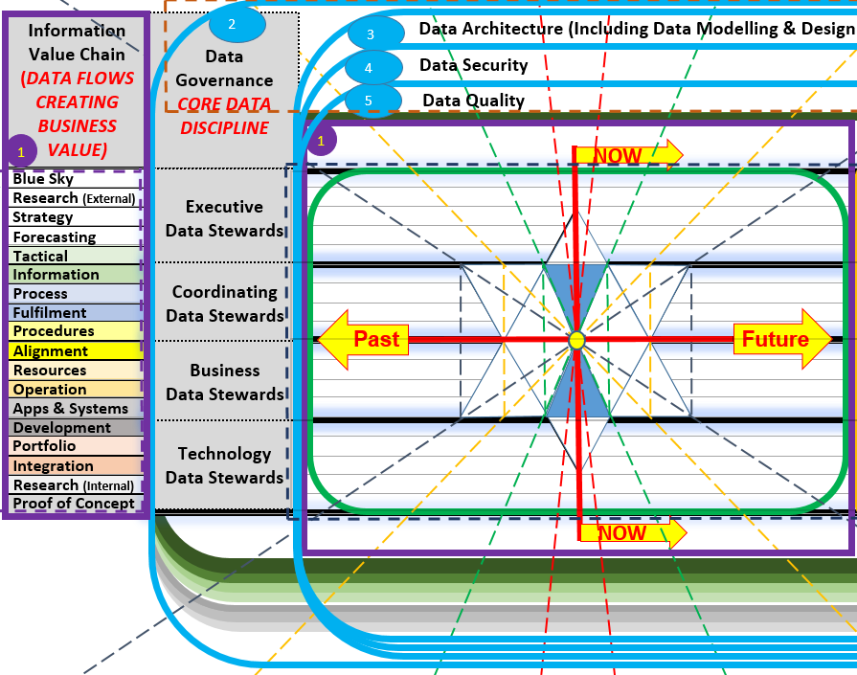
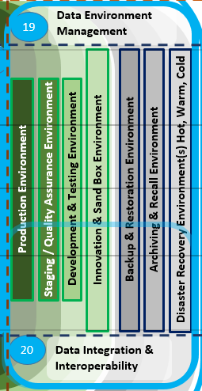
The CDO, CIO & CTO: “Common Structure”
Notes:
The CIO is accountable for providing the mechanisms and software tools that allow humans and other external data sources to be captured into a set of Business and Operational tools that provide the business processes with the correct data at the time that is necessary, to be presented as information in the form of combinations of data from various sources.
To achieve this the CIO has to bring on board systems and applications developed in different places of the world, with different mind-sets and cultures, and usually using different terms for the same or similar definitions already used in the Enterprise.
Further to this different Programming languages, and human programers also have their own personal languages and this can easily lead to misdirected actions when IT humans interact with a Business Requirement Specification without the ability to question what is actually meant by the business persons that created it. The Agile methodology of putting this group of people in the same room goes some way to resolving this divide in understanding, however, the different “Agile” initiatives on different projects or as business initiatives are still left to misunderstand one another at the more macro level. The consequence is therefore misunderstanding and confusion at the highest level of the Enterprise.
The CIO must therefore engage their various staff members in contributing to system, Application and programming specific Terms and Definitions, prefixing each with the source of the approved term, and these must each be related to the Definitions that exist in the Global Glossary, or in the specific Industry of vocational glossaries.
To the CIO, the statement to Business is “If you put Garbage-In, we can only give you Garbage-out” is not a statement that should be allowed in any business. By mapping and educating the IT staff on the “Single Enterprise Language”, misunderstanding through ambiguity and confusion can be reduced, and the IT staff can detect when they are being asked by one Business Unit to do something that would unwittingly harm another’s information.

Slide 104
V3.0 Workshop Agenda (CD&AO Conference)
1. Simple Understanding of Data ………………………………………………………. 15 mins
2. The Information Value Chain in your Enterprise …………………………….. 10 mins
3. Enterprise Architectures across Information Value Chain segments .. 10 mins
4. Time, Control, Delivery, Cost & Effort Considerations …………………….. 10 mins
5. Identify KPAs for data stewardship …………………………………………………. 15 mins
6. Identify KPIs which address the Information Value Chain segments .. 20 mins
7. Determine Information Value Chain Segment Metrics ……………………. 30 mins
----------- Body Break ………………………………………………………………………….. 10 mins
8. Establish your As-Is Data Governance Maturity and Capabilities …….. 20 mins
9. Define Data Stewardship Governance expectations for the Metrics .. 20 mins
10. Define Reporting Measures for the Metrics ………………………………….. 20 mins

Slide 105
7. Establish your As-Is Data Governance Maturity and Capabilities
Please email all queries to Herman.Badenhorst@edgedatawave.co.za,
- Start your message with:
- The company name you are representing;
- followed by your name;
- followed by your email address;
- followed by a message title (I will need context to understand the question); and
- followed by your question.
Answering of questions received during this workshop, AND which are pertinent to this workshop topic is free, only if submitted and received during this workshop.
Answers may be given during or after the workshop, or over the next few days. You are also welcome to engage me for training and consulting.

Slide 106
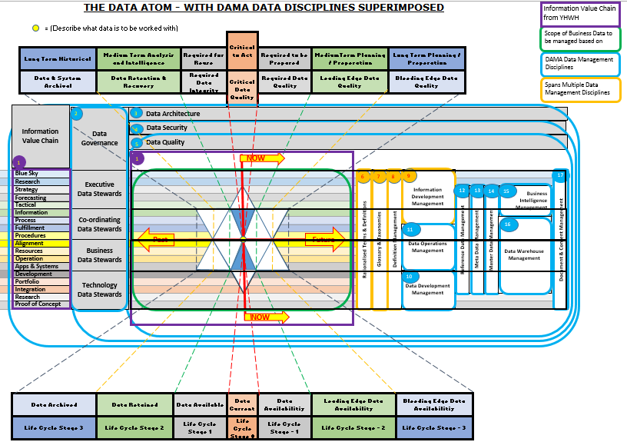
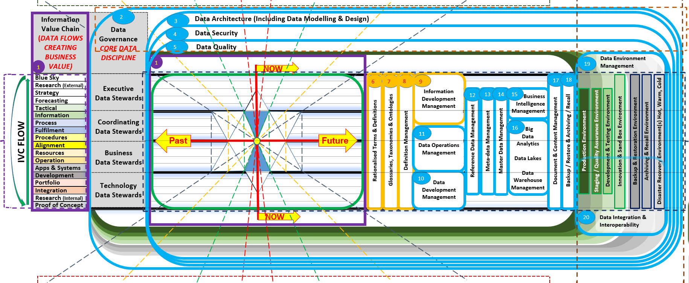
Enterprise Data Management V3.0
Notes:
This is therefore the whole slide presentation wrapped up into a single graphic and which you have each received a copy of. If you have not, feel free to request one from Data Atom.
Any Questions?

Slide 107
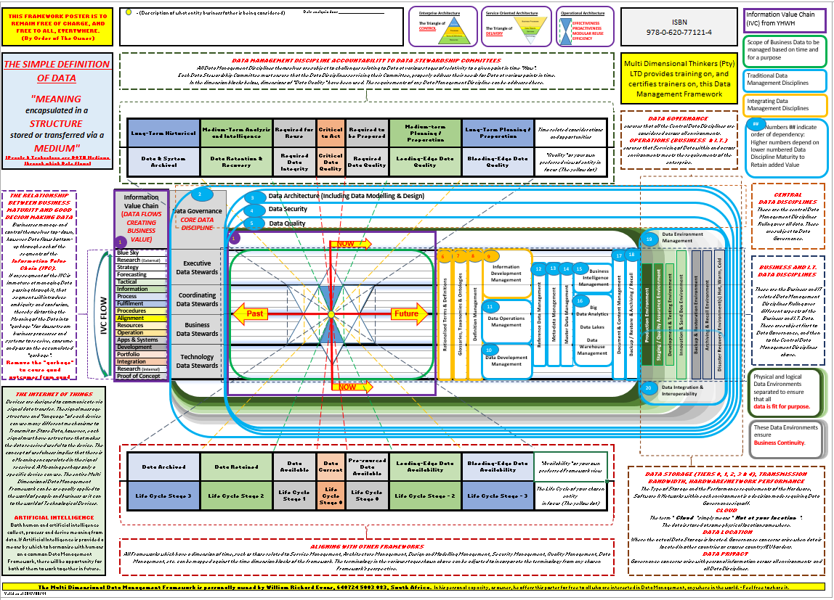
The Multi Dimensional Data Management Framework V3.0)

Slide 108
Data Governance Metrics
Business need(s) being addressed
Approach used to design, develop and implement the program
Scope and depth of the Data Governance Program as well as program longevity
Data governance defined roles and responsibilities
Communications and marketing approaches
Policies, procedures and processes established
Program metrics and business value provided

Slide 109
9. Define Data Stewardship Governance expectations for the Metrics
Please email all queries to Herman.Badenhorst@edgedatawave.co.za,
- Start your message with:
- The company name you are representing;
- followed by your name;
- followed by your email address;
- followed by a message title (I will need context to understand the question); and
- followed by your question.
Answering of questions received during this workshop, AND which are pertinent to this workshop topic is free, only if submitted and received during this workshop.
Answers may be given during or after the workshop, or over the next few days. You are also welcome to engage me for training and consulting.

Slide 110
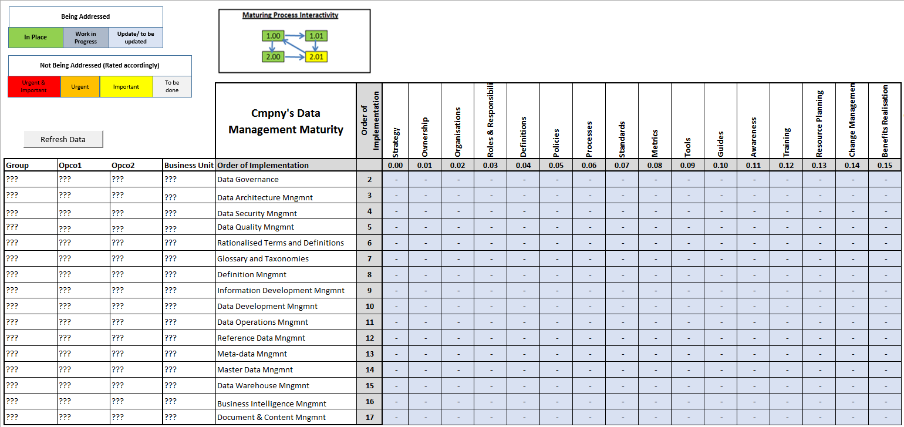
The CDO’s Maturity Measures
Notes:
In simple terms this is a matrix of Master Records that an Enterprise Data Architect would ensure exists to the level useful for Enterprise Data Architecture, and specifically to address the goals and accountabilities of the CDO in particular, and the Enterprise in general.
The Data dimensions have been indicated down the left column and these are the DAMA Data Management dimensions, which have been expanded to address the new areas of the model that speak to the Rationalised Terms and Definitions, Glossary and taxonomies, Definition Management, Information Development Management and Data Operations Management.
Across the top are artefacts that by their intersection with the Data Dimensions, provide “Pigeon holes” into which URLs to the respective specific artefacts can be found together with the metadata around who is busy with each, when last, the decay date, other areas using the same artefact, its purpose and any further comments.
Each of the intersections would be rated in terms of their maturity and trust in terms of usefulness and relevance. And colour coded to indicate the state of development or dependence. The entire grid is an ecosystem which starts with the cornerstone of the Enterprise’s Data Governance Strategy at the top left and everything flows from this strategy thereafter. Working on something in an isolated manner, such as Master Data Management, when Meta-data Management’s artefacts above and to the left have not been addressed is simply looking to waste effort and resources. Growing the Ecosystem is an accountability of the CDO, and a responsibility of the Enterprise Data Architect, with ratification from Enterprise Data Governance.
I

Slide 111
10. Define Reporting Measures for the Metrics
Please email all queries to Herman.Badenhorst@edgedatawave.co.za,
- Start your message with:
- The company name you are representing;
- followed by your name;
- followed by your email address;
- followed by a message title (I will need context to understand the question); and
- followed by your question.
Answering of questions received during this workshop, AND which are pertinent to this workshop topic is free, only if submitted and received during this workshop.
Answers may be given during or after the workshop, or over the next few days. You are also welcome to engage me for training and consulting.

Slide 112
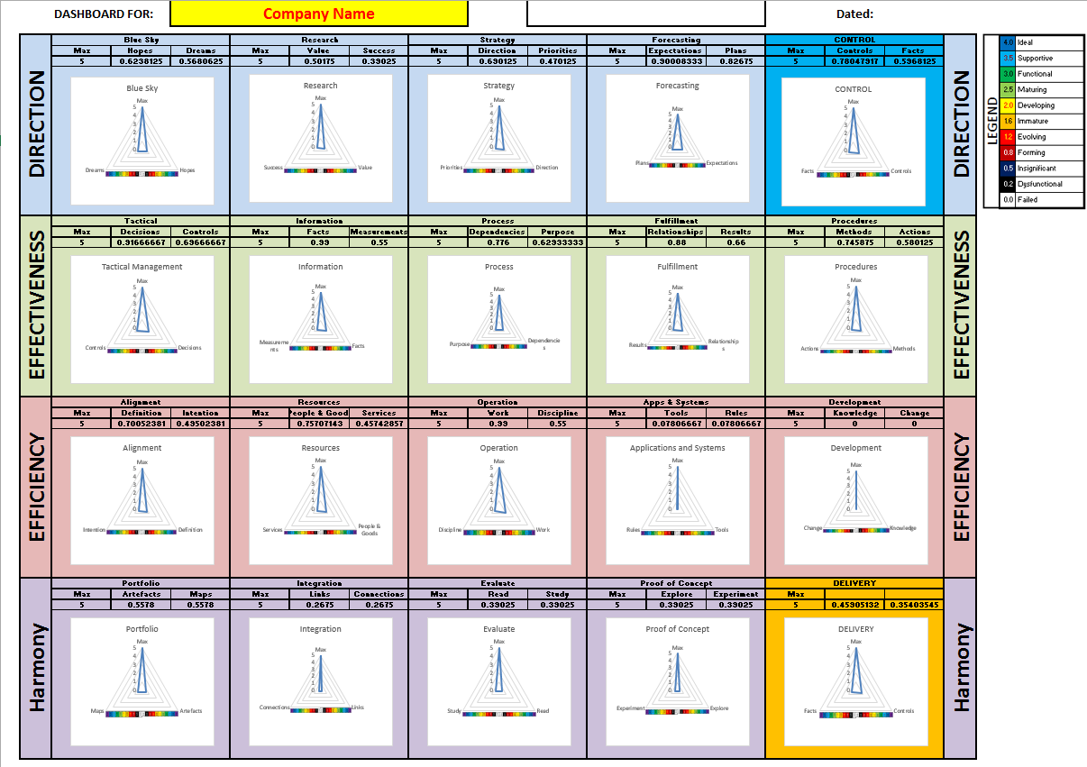
Identifying the Information Value Chain Segment Maturity constrictions
Notes:
The Information Value Chain Segments themselves have dimensions which allow measurement of the maturity of each segment. Understanding where skewing is taking place int the Information Value Chain, or where there are constraints preventing successful delivery of data through its cycle provides the CDO valuable information about where to place effort in the business to gain the fastest maturity of that segment.
For the first time it also provides the CIO and the CTO with a defendable argument when engaging with the CFO, who is usually the one armed with most of the details in a measured form.
While finance requests budgets from the Business in terms af what the different cost centres intend spending and on what, the CDO has a similar requirement on the Business in terms of understanding what would be done by each Business Unit in each of the Information Value Chain Segments to grow and mature their ailing segments. Along with this effort also comes an additional cost to be budgeted for, which must either be borne centrally under the CDO, or by each of the other “C” levels (including the CIO and CTO.
Naturally increasing maturity and flowing de-duplicated cleansed data has a positive spin-off on the Business and its profit to earnings ratio, through the cost saving at each part of every Business Process, and procedure and human and technology actor, that delivers better, creates less fires, and thereby entices new clients through a greater value to the market. At the end of the day the CFO smiles anyway.

Slide 113
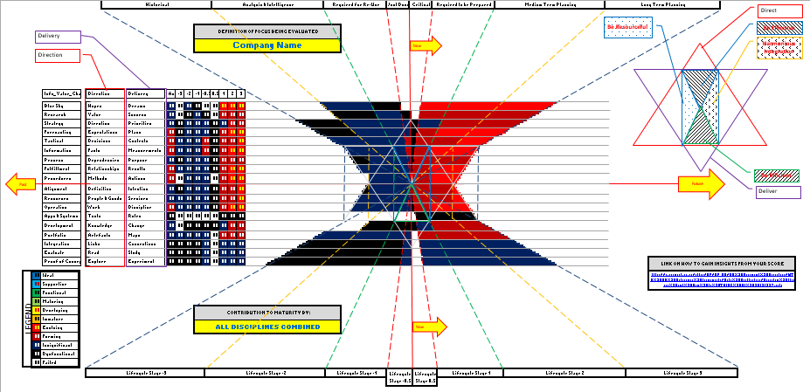
The CDO Dashboard - activated
Notes:
The Chief Data Officer’s Dashboard when activated takes the scores from various viewpoints of the Enterprise’s layers and overlays them so that an indication of true data capability to meet the Business Benefit Realisation can be determined.
Overlays would include, one or more Business Units involved, The Enterprise Architecture and the various other architectures and their models relating to the area under discussion, the Project/Initiative’s Solution Architecture, and various other overlays which when combined provide an understanding of what data will be needed when, and what is the likelihood that this data will be fit-for-purpose in a sustainable way, sufficient to drive the decision as to when a project should best be launched for it to achieve the greatest success for Business.
If the data is not fit-for-purpose, why pay for resources to sit around waiting, or attempting to run test data on personally created “bug-free” data, which provides for an excellent solution in a sterile environment, but one that fails in reality.
The Questions and Answers can be of your own making, or you can use standard ones which identify Effectiveness, Efficiency, usefulness, functionality and development.

Slide 114
MDDMF v3.0 Initial unpacking (2017-2018)
End of MDDMF Version 3.0
  Click to Return

Slide 115
MDDMF v4.0 Addition of concepts fundamental to Data (2018-2020)
William Re-Certified as a DAMA CDMP
Applied the Framework within a UK Financial Institution as Data Governance Framework Manager
Aligned to the Gartner Information Management Model
Provided the V1.0 Graphic as the base to design the Metamodel for the Metadata Management Tool
Educated senior and other level staff on insights and considerations
  Click to Return

Slide 116
11. Identify Business Maturity and Align for free data flow
Please email all queries to Herman.Badenhorst@edgedatawave.co.za,
- Start your message with:
- The company name you are representing;
- followed by your name;
- followed by your email address;
- followed by a message title (I will need context to understand the question); and
- followed by your question.
Answering of questions received during this workshop, AND which are pertinent to this workshop topic is free, only if submitted and received during this workshop.
Answers may be given during or after the workshop, or over the next few days. You are also welcome to engage me for training and consulting.

Slide 117
Aligning the Business to manage data

Slide 118
4 Things Time does to your Data.
Using Data Governance to
Avoid Truth Decay
Presented by: William Evans
The Multi Dimensional Data Management Framework (MDDMF 4.0)
Multi Dimensional Thinkers is a free, non-membership, Forum ….
with a few useful insights to share

Slide 119
Big Data 2019
4 Things Time does to your Data. Using Data Governance to Avoid Truth Decay
12 Mar 2019
16:35 - 17:00
Data Management & Integration Theatre
Stories to help you understand the effects of time and "seasons" on your data. Reading the signs of the likelihood of what "weather" you will be experiencing tomorrow, and equally important, what weather you had last week that is currently prompting you to rethink the architecture of your IT Estate, or for that matter the re-organisation of your Enterprise. You may want to think differently about everything first before you do this, because Time will cause you to struggle more. The more a cat plays with a ball of wool the more tangled it gets. How do you get your data right. I expect you will have many "aha" moments in this talk. "Gravity is to our humanity as Time is to Data."

Slide 120
Impact of Time on your Data
What is time?
Time is a dimension.
We know the past exists (we have shared memories and records)
We assume based on past experiences that there is a future
We know based on observation that for some their future “ceased”
Everything is subject to the effects of time.
1. Data Decay (Data rots and contaminates good data)
2. Latency (Data can arrive too late causing issues)
3. Data in the minds of people (blocking new ways of Data Management)
4. Data Management Maturity (evolving with ageing data & systems)

Slide 121
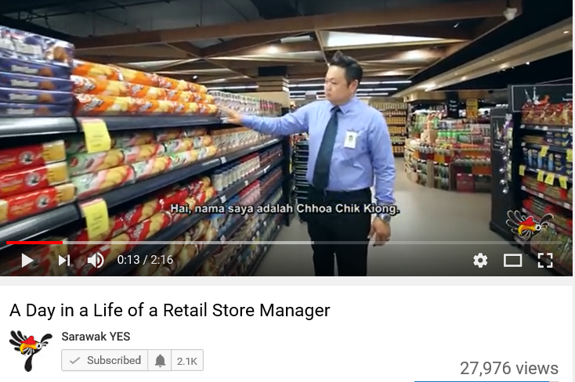
Experiences: Data Decay
https://www.youtube.com/watch?v=Bx0okLlcaC4

Slide 122

Data Decay
All Data has a decay rate, each data asset decays due to forces beyond our view.
Assess the forces changing the truth of your data as it relates to the real world around you (but do not change history, rather process a contra entry.
Test and quality spot check to find decayed data quickly, because decayed data corrupts good data – you lose trust, even in the good data around it
The Analogy of A Supermarket. (Data Decay is a constant threat)
  All the items are different data assets
  All the people are data stewards of the data
  The customers are the users
https://www.youtube.com/watch?v=Bx0okLlcaC4

Slide 123
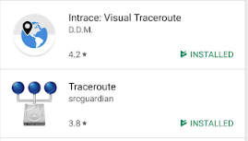
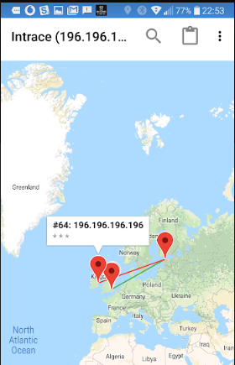




Experiences: Latency
https://www.youtube.com/watch?v=Nma5OfNRExE

Slide 124

Latency
Latency: Who should have the better response time?
You / Your Customer?
https://www.youtube.com/watch?v=Nma5OfNRExE
Use a cloud that is based closer to those who need the best response times.
Use friendly Customers: Ask them to do a spot test of your latency: Click> Start Button > Run > “CMD” > “Tracert <<Your website>>”
Add Up all the milliseconds through all the hops it took to get there.
The ideal is less than 200ms “Blazing Fast” = a total of 10ms.

Slide 125


Experiences: Data in the minds of people

Slide 126








Data flows change over time creating stagnant pools and laying down different layers of meaning
https://www.youtube.com/watch?v=izgc3vFimP8, https://www.youtube.com/watch?v=jGhogd0G7_U, https://www.youtube.com/watch?v=tgp-v7mcjFM
Data Meaning changes over time. Understand what meant what, and when in the past so that you make no mistakes in the future

Slide 127
Data in the minds of people
IP sits in the minds of people – Staff Churn destroys “Journey-knowledge”
Migrating from a Silo based enterprise to implementing MDM
1. Understand each business view of the data
2. Develop the Meta-data for each view
3. Get the Business Processes harmonized around an agreed single view
4. Migrate the human-working of the business to work in one way using the different Meta-Data to bring alignment
5. Embed the processes Manually and bring discipline to way of work
6. Implement MDM and use the Meta-data to align and migrate thoughts

Slide 128
Acquisitions and mergers (and Backwards Compatibility)
The Data restored has different formats to what the system has been changed to now.
  Different/Changed meanings of terms and definitions
  Different/Changed standards and protocols
  Decisions made based on previously existing policies, legislation, procedures
  Procedures that catered for data quality anomalies
  Field length, Special character use, permitted file sizes, readable file types.
Insist on a full historical explanation of the IT Estate, and what was bought and used and integrated into what at what time.
Understand the history of the changing data flows … because all that data is “living” in time-layers in your Data-Stores

Slide 129
Visual of Data (An Invoice)
Meta-data
Reference Data
Master Data
Transactional Data

Slide 130
Analogy: When weaving a carpet, there are 3 different threads. Each thread is a data attribute. Each millimetre of thread is instantiated data of the attribute of that thread.
Here is a simple explanation of Data Functioning in an Enterprise
Discuss The analogy and the types of Data

Slide 131
A small company weaving a transaction
https://www.youtube.com/watch?v=aT6gx4db7z8

Slide 132
Siloed Management of Data in systems
https://www.youtube.com/watch?v=ZYU5T9t7-oo

Slide 133
Business Silos with their own Data Sources
https://www.youtube.com/watch?v=Sztvjrkixzs

Slide 134




An Effective Data Governed Enterprise
https://www.youtube.com/watch?v=zhzf6cIEGM8

Slide 135
The best Data Manager, will be the person who is … a good Gardener. https://www.youtube.com/watch?v=1e0NDruyU0U
Time impact and cycles and windows of opportunity in a Garden must be paid attention to.
The Gold Analogy does not really work anymore, because gold does not decay,
However, all data is fluid and subject to time, much like a garden.
You can only pick and use the roses in a certain window of opportunity.

Slide 136
Enterprise Data Management V4.0
1
Notes:
This is therefore the whole slide presentation wrapped up into a single graphic and which you have each received a copy of. If you have not, feel free to request one from Data Atom.
Any Questions?

Slide 137

The Multi Dimensional Data Management Framework V4.0)

Slide 138
MDDMF v4.0 Initial unpacking (2018-2020)
End of MDDMF Version 4.0
  Click to Return

Slide 139
MDDMF v5.0 Addition of metadata and the environmental considerations (2021-2022)
William Re-Certified as a DAMA CDMP
Applied the Framework within a SA Financial Institution as Information Architect.
The team of architects positioned themselves to understand their areas of influence and control to design and deliver the project harmoniously
Practically implemented components of the Framework, focusing on Data Governance, Definition Management, Metadata Management, Business Glossary, Data Dictionary, Data Quality, and contributing to Reference and Master Data
  Click to Return

Slide 140
12. Identify Real Details and Map to Virtual
Please email all queries to Herman.Badenhorst@edgedatawave.co.za,
- Start your message with:
- The company name you are representing;
- followed by your name;
- followed by your email address;
- followed by a message title (I will need context to understand the question); and
- followed by your question.
Answering of questions received during this workshop, AND which are pertinent to this workshop topic is free, only if submitted and received during this workshop.
Answers may be given during or after the workshop, or over the next few days. You are also welcome to engage me for training and consulting.

Slide 141
Implement the Metadata to enable Technical Support of the Data Management Capabilities

Slide 142
Enterprise Data Management V5.0
Notes:
This is therefore the whole slide presentation wrapped up into a single graphic and which you have each received a copy of. If you have not, feel free to request one from Data Atom.
Any Questions?

Slide 143

The Multi Dimensional Data Management Framework V5.0)

Slide 144
MDDMF v5.0 Initial unpacking (2021-2022)
End of MDDMF Version 5.0
  Click to Return

Slide 145
Version 6.0 Addition of Information Management Capabilities, and A.I. Partnership (2022-08-04 - …)
William remains certified as a DAMA CDMP until December 2024
Next Application of the updated MDDMF to be determined.
  Click to Return

Slide 146
13. The Information Components in your Enterprise
Please email all queries to Herman.Badenhorst@edgedatawave.co.za,
- Start your message with:
- The company name you are representing;
- followed by your name;
- followed by your email address;
- followed by a message title (I will need context to understand the question); and
- followed by your question.
Answering of questions received during this workshop, AND which are pertinent to this workshop topic is free, only if submitted and received during this workshop.
Answers may be given during or after the workshop, or over the next few days. You are also welcome to engage me for training and consulting.

Slide 147
Decision Making Information Components

Slide 148
Applying MDDMF 6.0 to Business Information

Slide 149
A. I. mechanisms to evolve humanity

Slide 150
14. Identify Information mapping to Data
Please email all queries to Herman.Badenhorst@edgedatawave.co.za,
- Start your message with:
- The company name you are representing;
- followed by your name;
- followed by your email address;
- followed by a message title (I will need context to understand the question); and
- followed by your question.
Answering of questions received during this workshop, AND which are pertinent to this workshop topic is free, only if submitted and received during this workshop.
Answers may be given during or after the workshop, or over the next few days. You are also welcome to engage me for training and consulting.

Slide 151
Map the Information to the underlying Data

Slide 152
Enterprise Data Management V6.0
Notes:
This is therefore the whole slide presentation wrapped up into a single graphic and which you have each received a copy of. If you have not, feel free to request one from Data Atom.
Any Questions?

Slide 153
The Multi Dimensional Data Management Framework V6.0)

Slide 154
MDDMF v6.0 Initial unpacking (2022-08-04 - …)
End of MDDMF Version 6.0
  Click to Return

Slide 155
END OF SLIDES – MDDMF v1.0 - v6.0
End of MDDMF Version 1.0 to Version 6.0
  Click to Return

